Slide 1
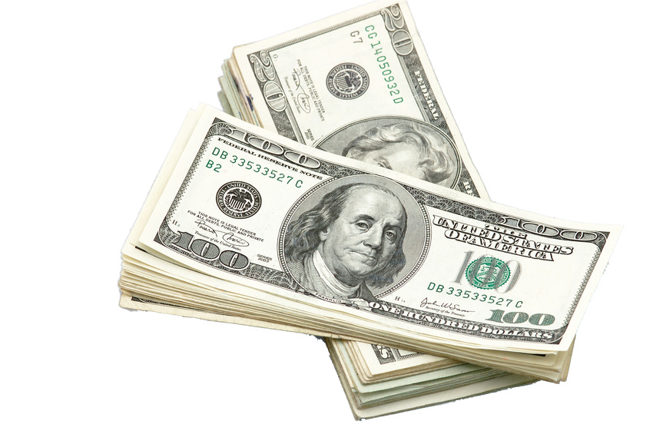
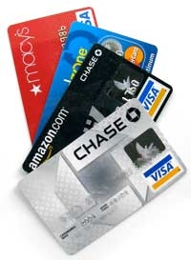
The Basics of Banking:
How to Manage Your Money in the United States
Alana Schriver, Omaha Public Schools

Slide 2
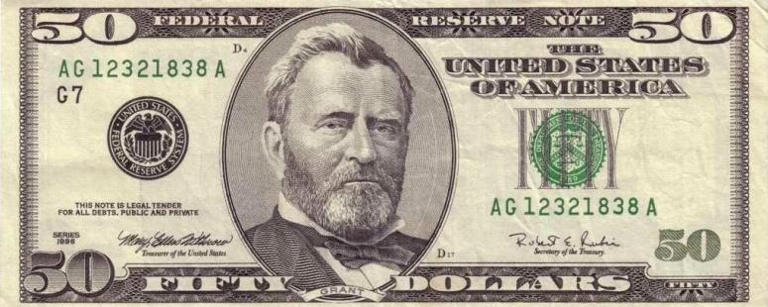
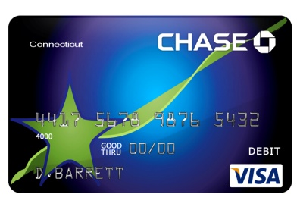
Cash versus Card
Cards are accepted almost everywhere in the U.S.
It is safer to carry a card than cash.
If you lose your cash, it is gone and you cannot get it back.
Thieves know that immigrants usually carry cash.
This makes you a target – especially on common paydays.
If you lose your card, call the bank IMMEDIATELY and CANCEL IT!
Once canceled, the card will no longer work and no one can access your money. Your bank will send you a new card.

Slide 3
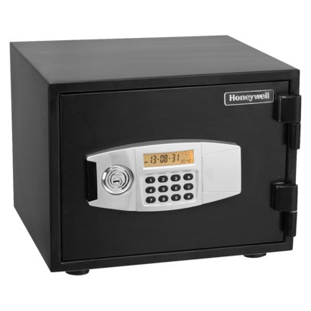
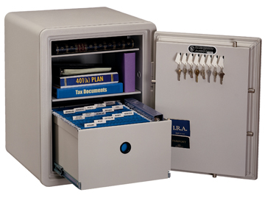
Keep Money Safe at Home, too!
It is not a good idea to keep large sums of cash at home.
The money can be stolen or lost in a fire.
It’s better to keep your money at the bank.
If you absolutely need to keep cash at home, buy a fire-proof safe from Walmart:

Slide 4
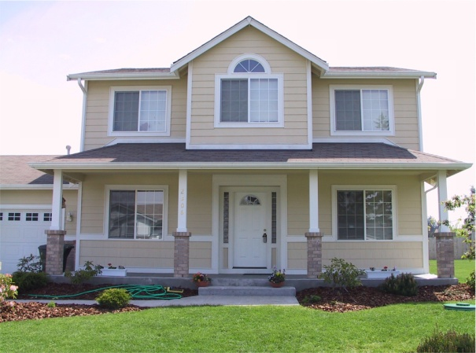
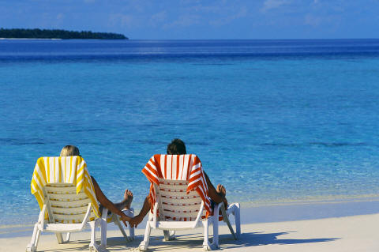
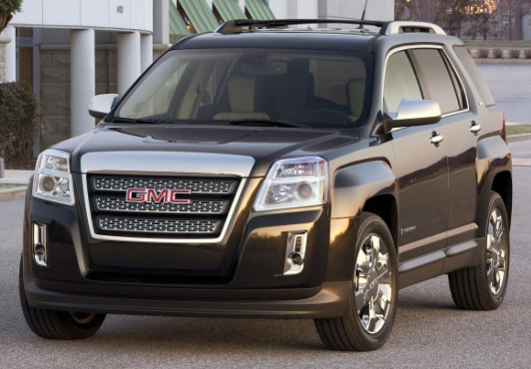
Checking versus Savings Accounts
“Checking” is the money you use to buy everyday items and pay your regular bills.
“Savings” is money you put aside for future use.
Examples of things you might save for:
- Car - Retirement
- House - Emergencies
- College - Travel

Slide 5
What is a balance?
Your “balance” is how much money is available in your bank account.
After you write a check or use your debit card, subtract the amount you spent from what you had in your account. The new amount is your available balance.
$400 - $150 = $250 balance

Slide 6
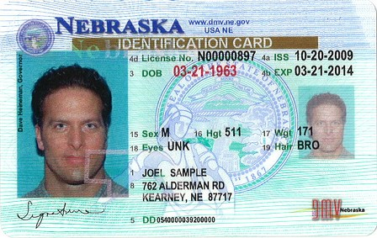
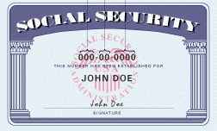
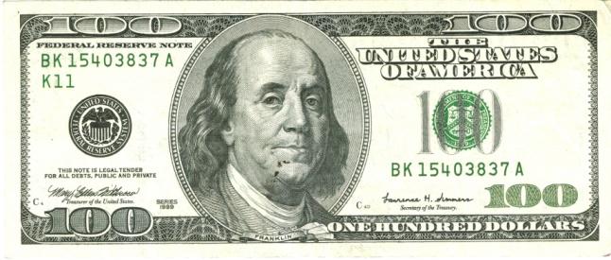
How to Open a Bank Account
What do I need?
Photo ID
Social Security Card
Money to deposit
How do I choose a bank?
Choose one that is close to your home
Choose one that has limited fees

Slide 7
Bank Fees
Banks may charge fees for different things, and the amounts they charge could be also be different.
It is important to compare fees between banks so you get the best deal for your needs.
Possible Fees:
Monthly / Annual
Overdraft / Insufficient Funds
(explained in separate slide)
ATM
(explained in separate slide)
Minimum Balance
Returned Deposit (if you cash a check from someone else and they don’t have enough money to cover it.)
Transaction (charge for deposits, withdrawals, transfers)

Slide 8
What is an Overdraft?
“Overdraft” is when you use your card (or write a check) when there is not enough money in your bank account to cover the cost, so the bank pays the remainder and then charges you a fee for that service.
The bank will charge you a fee EVERY SINGLE TIME you overdraft!
Please note: Your debit card can still work even if there is no money in your bank account. It is up to you to keep track of how much money you have in your account.

Slide 9
How do I avoid an overdraft?
Write down what you spend!
Keep a notebook and write down every time you use your card or write a check. Do the math and make sure there is enough money left in your account before you spend again.
Ask your bank if they can change your account so that the debit card will not work if there is not enough money available.
This may keep you from overdrafting with your card, but you can still overdraft if you write a bad check.
$1000.00 deposit
$400.00 rent
= $600.00 balance
$75.00 food
= $525.00 balance
$100.00 OPPD
= $425.00 balance
$60.00 gas
= $365.00 balance

Slide 10
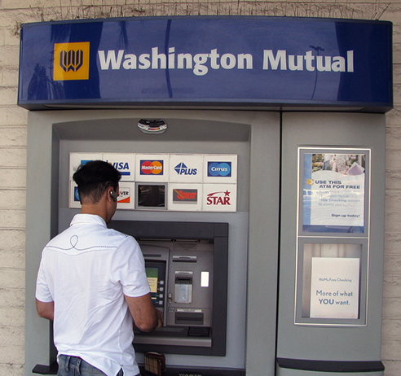
ATMs
“ATM” stands for Automated Teller Machine
What can I do at an ATM?
Withdraw cash - Check balance
Deposit checks - Transfer funds
Fees: If you use an ATM from your own bank, there is no fee. If you use an ATM unrelated to your bank there will be probably be a fee.

Slide 11
What is a “PIN”?
PIN stands for Personal Identification Number.
This is a secret number that you choose so that no one else can use your card.
Choose a number that is easy for you to remember, but not easy for someone else to guess.
1982
9475
3300

Slide 12
Debit Cards versus Credit Cards
Debit cards and credit cards can be used the same way at the same places. The difference between them is in where the card pulls the money from.
DEBIT cards (ATM cards) are connected to the money your checking account. It is money you have already earned. It is your money.
A CREDIT card is borrowed money.
If you have “good credit” you might be approved for a credit card. Good credit is earned by always paying your bills on time; showing you are financially trustworthy.

Slide 13
Risks of using a Credit Card
Credit cards are not a good idea for everyone. They can get you into a lot of financial trouble if you are not careful.
You are charged interest for purchases made with a credit card. Most credit cards charge very high interest.
Example: If you spend $100 at 20% interest and you do not pay off the entire $100 on time, you now owe $120 to the credit card company. If you are late a second time the interest can go up even higher, and so on.

Slide 14
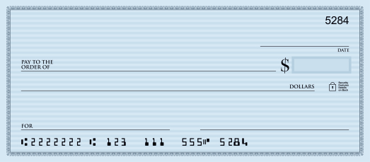
How to Write a Check
Your name and address
Today’s date
The name of the business or person you are paying
Amount in numbers
Money amount written out in words
Reason why you are paying
Signature

Slide 15
Sample Check
Alana Schriver
3260 Davenport ST
Omaha, NE 68131
3/27/13
Landmark
125.00
One hundred twenty-five dollars 00/100 -----------------------
Alana Schriver
Rent

Slide 16
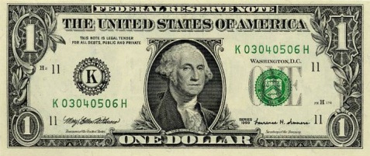
Questions?

