Slide 1
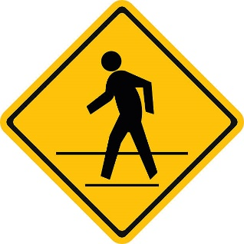
Rules of the Road:
Pedestrians and Bicyclists
Alana Schriver, Refugee Specialist, Omaha Public Schools 2018

Slide 2
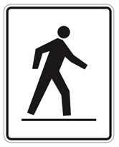
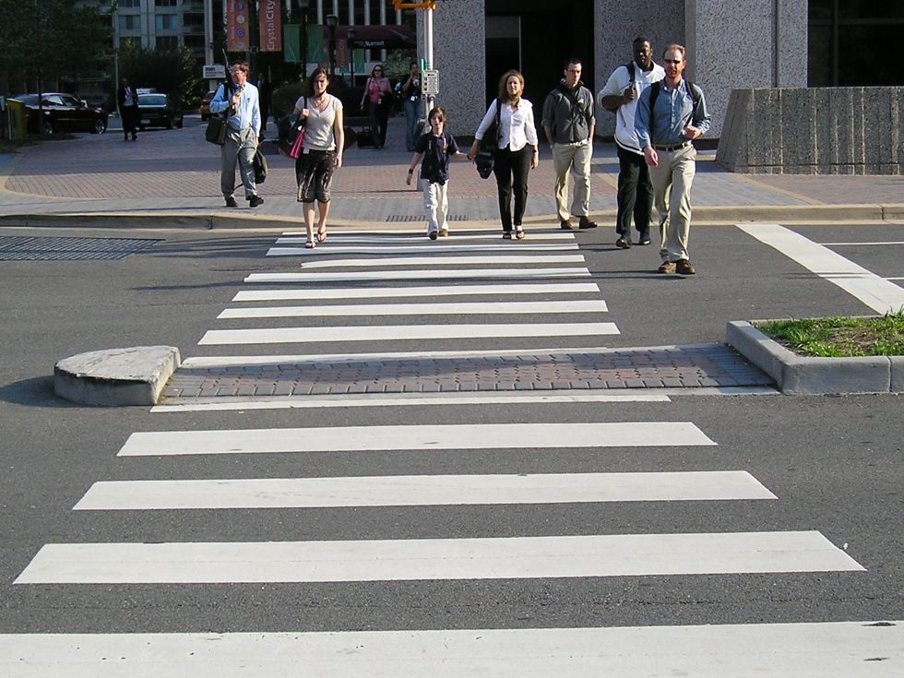
Crosswalks
Crosswalks are officially marked parts of a street where pedestrians can cross safely and legally.

Slide 3
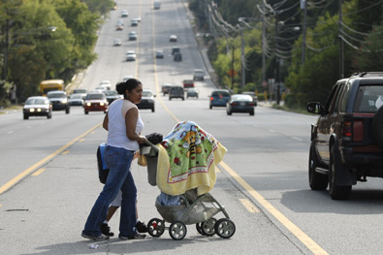
Corner Crossing
Always try to cross streets at the corner, even if no official crosswalk is marked.
The safest place to cross is at a corner of a street.
Drivers do not expect people to walk into the street in the middle of a block.
Attempting to cross a street mid-block is the most common cause of injury.
NO!

Slide 4
Obey Signals
Look for signals at crosswalks and obey their instructions.
Start walking only when "WALK" or the image of a person walking is displayed.
If the red hand is flashing, that means the signal is about to change. You may continue to cross as quickly as possible if you have already started. If you haven't started crossing yet and the hand is flashing, wait for the next green light.
Never start walking when a "Don't Walk" or the solid red hand symbol is displayed.

Slide 5
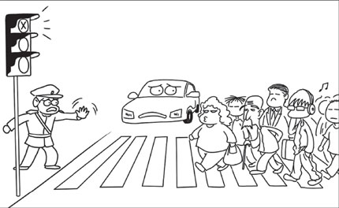
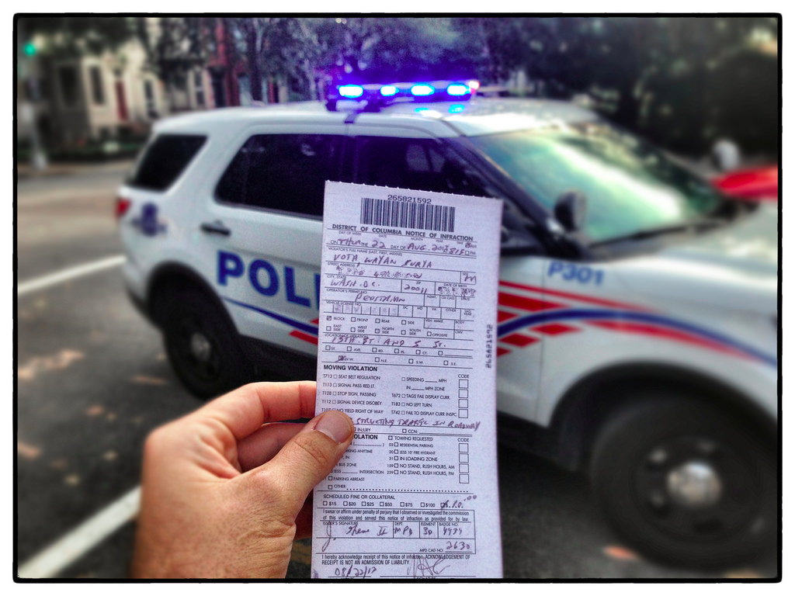
Jaywalking
Not obeying the crosswalk signals is called “jaywalking” and is illegal.
You can be ticketed and fined by the police for crossing a street unsafely.
Penalty for Disobeying a Pedestrian Crossing Signal in Nebraska:
$10 + $48 in court costs = $58

Slide 6
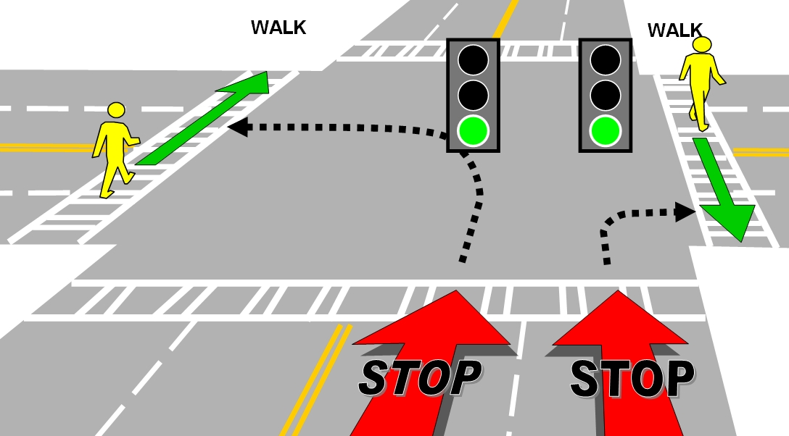
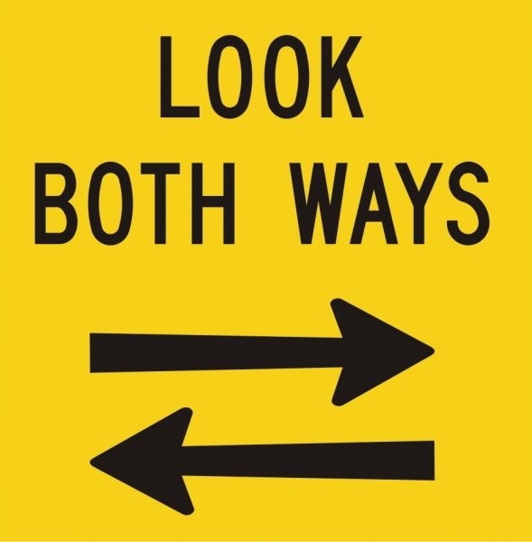
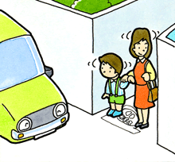
“Right of Way”
Pedestrians have the right of way if there is a crosswalk and the light is in their favor.
Give cars enough time to stop before entering the street.
Look to your right, left, then right again to check for cars before stepping into the street.

Slide 7
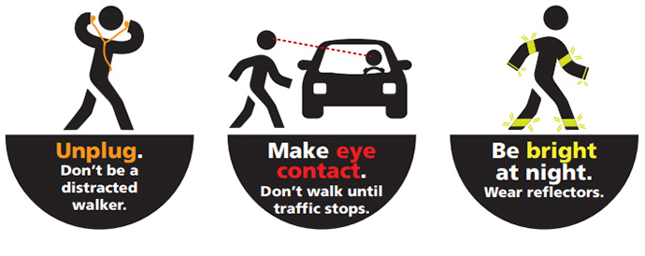
Safety Reminders

Slide 8
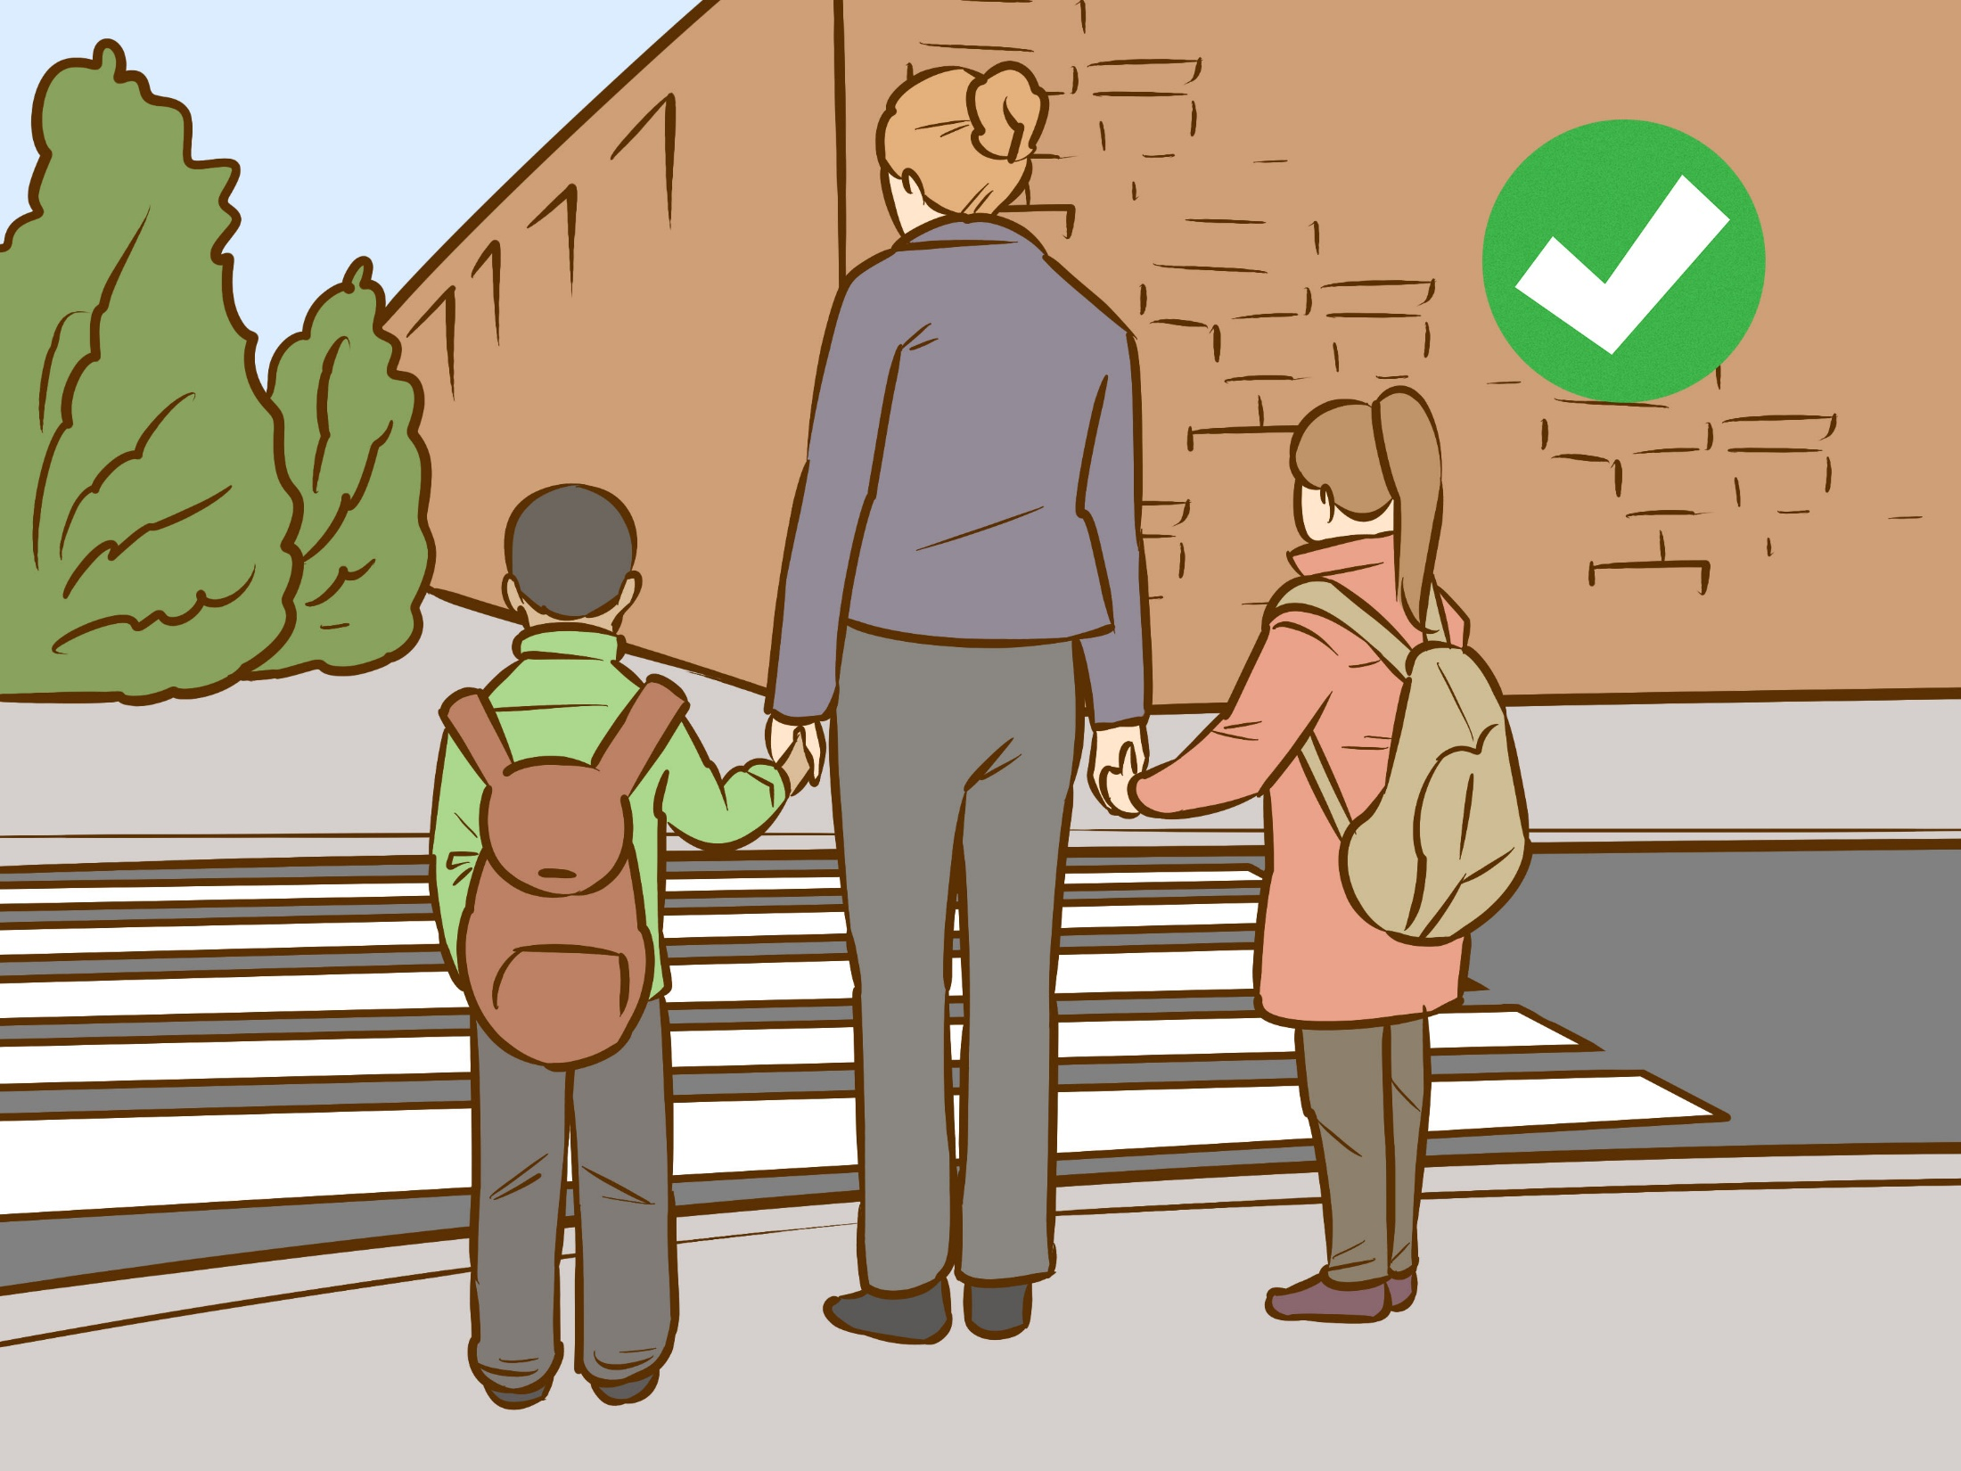
Talk to your children about the importance of street safety.
Teach them these important rules when you are walking together.

Slide 9
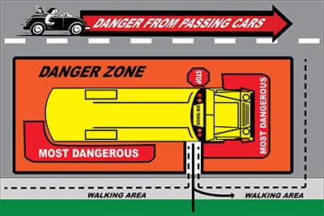
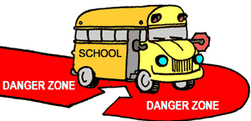
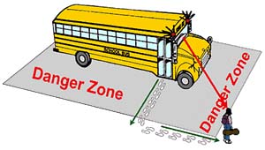
School Bus Safety
Find a safe place to wait for the bus away from traffic and the street.
Do not move towards the bus until it comes to a COMPLETE STOP!
Make eye contact and wait for the driver to signal you that it is OK to move towards the bus.
Be aware of the street traffic around you and the bus; only approach the bus from the “safe zone”.
When you are exiting the bus, use the safe zone and head straight for the sidewalk.
Only use crosswalks or corners to cross the street
– Never cross in the middle of a street!

Slide 10
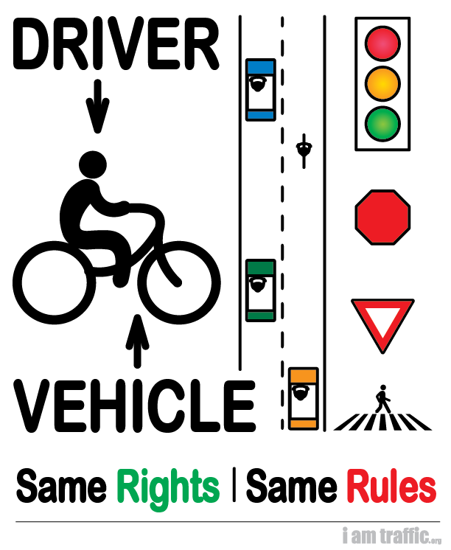
Bicycle Laws
Bicyclists must obey traffic signs and laws.
Not obeying the signs and laws can result in a fine, just like when driving a car.
Go with the flow of traffic, never against it.
Stay on the right side of the road.
Don’t ride too close to parked cars; doors may open suddenly.
Do not use the sidewalk.
If riding with friends, go single file.

Slide 11
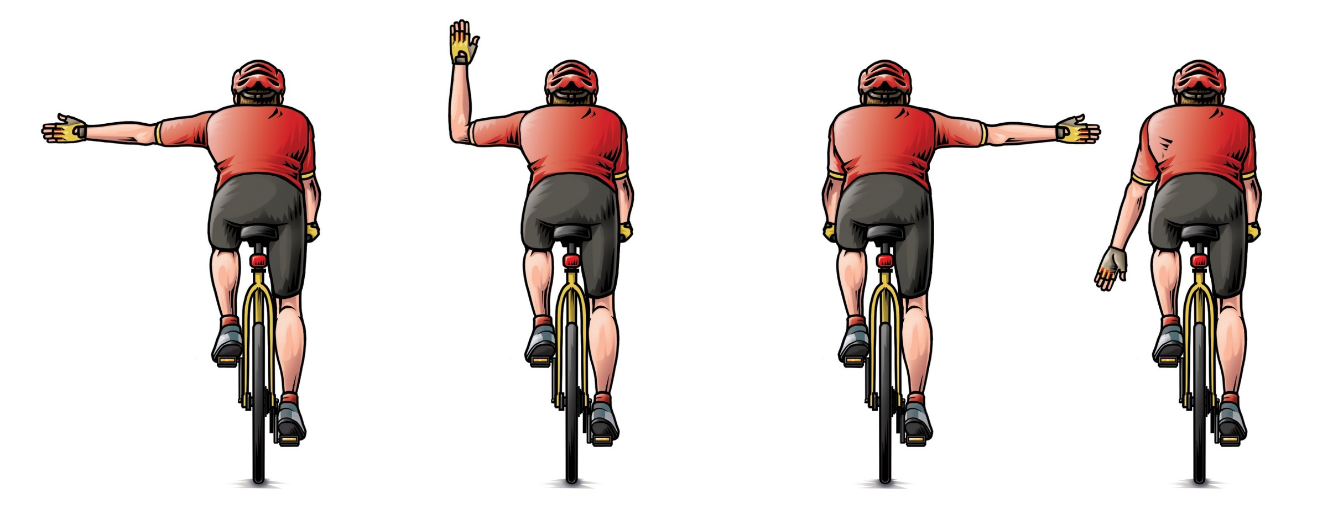
Signaling
Left Turn Right Turn (2 options) Stop

Slide 12
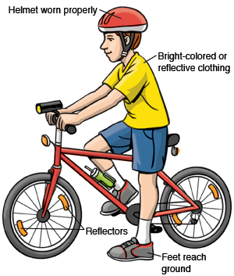
Bicycle Safety
Wear a helmet that fits securely
Wear bright or reflective clothing
Make sure your bicycle has reflectors on all sides
If you must ride at night, use a headlight
Keep your bicycle in good repair
Ride a bicycle that fits your body – your feet should be able to reach the ground easily
Never wear earplugs or use a phone while cycling

Slide 13
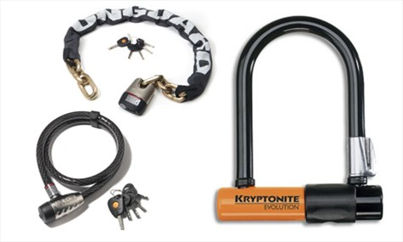
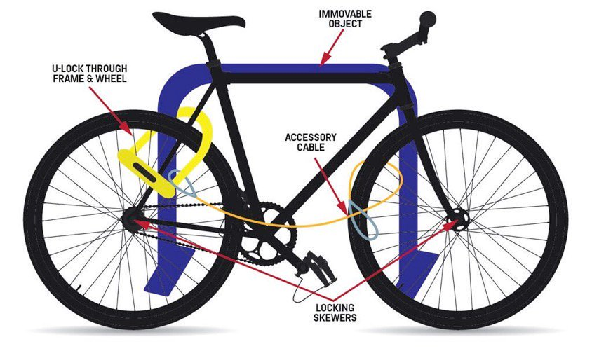
Lock it or Lose it!

Slide 14
