Slide 1
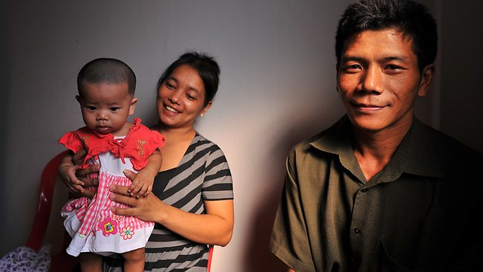



Adjusting to Life in America
Alana Schriver and Claire Herzog

Slide 2
Resettlement in America
The life of a refugee is not easy.
Moving to a new country and integrating into a new culture is very difficult.
Sometimes the stress becomes more than a person can handle and they need help.
Today we will talk about when and how to get help.

Slide 3



Culture Shock Cycle
Honeymoon
Integration
Adjustment
Culture Shock Crisis
Time in a new culture

Slide 4

Managing Expectations
Thinking about America before you arrive
Learning about the real America
Setting new, realistic goals for your life

Slide 5
What is Mental Health?
We all know it is important to keep our bodies strong. We know we should eat good food, exercise, and see a doctor when we are sick.
That is good physical health.
Mental health is just as important as physical health.
Mental health is about your thoughts and feelings.
We all need to practice good mental health.

Slide 6

It is normal to have different feelings.
Some days we feel very happy, some days we feel sad, angry, or worried. That’s OK.
Having good mental health means:
You can cope with the bad days
You are productive
You have healthy relationships

Slide 7

Sometimes our thoughts and feelings are not healthy.
We think too much. We feel bad more than we feel good.
We have a hard time going to work or talking to our friends and family.
Life feels hopeless and out of control.
This is called mental illness.

Slide 8

When our bodies get sick, people understand the sick person needs help.
It is important to treat mental illness with the same compassion and concern.
Mentally ill people need our love and support to get better.
Mentally ill people can get better.

Slide 9


Just like there are doctors and medicine for your physical health, there is professional treatment for mental illness.

Slide 10
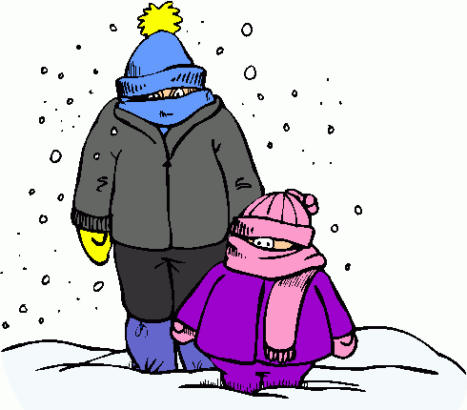
Winter Struggle
November – March
Cold, snowy, and dark
Affects almost everyone, not just immigrants

Slide 11
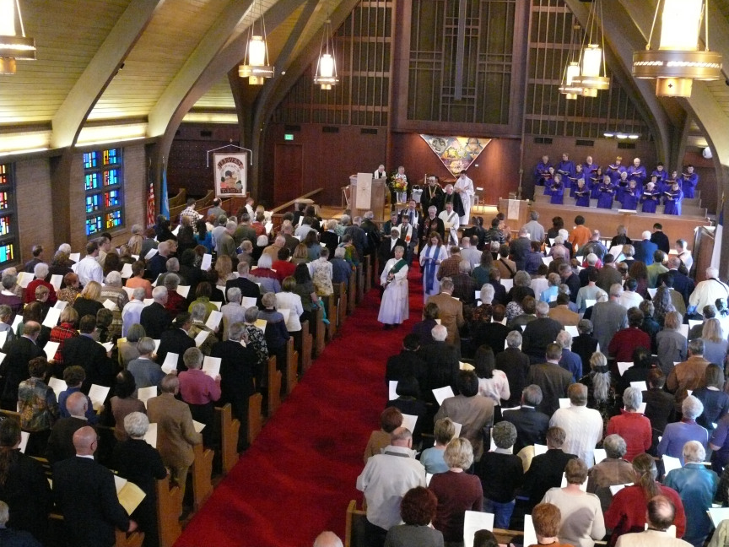
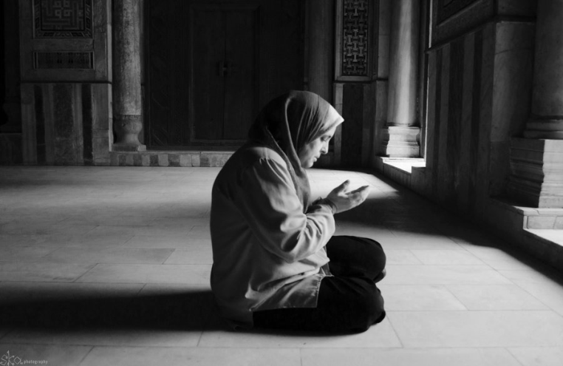
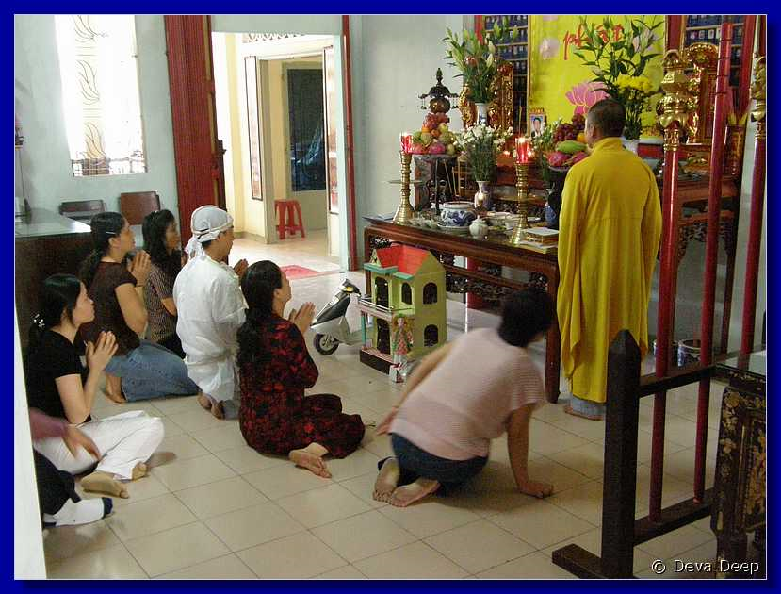
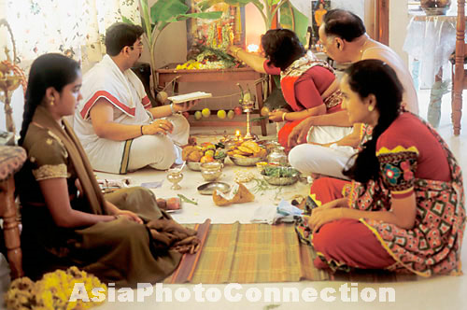
How to Feel Better
You must be active in finding ways to feel happier

Slide 12

How to Feel Better
Family time
Leaving the house
Keeping cultural traditions
Keeping religious traditions
Learning English
Making new friends
Exercise
Try something new

Slide 13

How to Feel Better
Slow, purposeful breathing
Become aware of stress in our body
Relax muscles

Slide 14

What is Normal
When do we need professional help?
Is it causing problems in your life?
Are you able to work?
Is your family worried?

Slide 15

Depression
“Thinking too much”
Feeling sad too often
Changes in eating
Changes in sleeping
Not caring about life
Thoughts of suicide

Slide 16

Anxiety
Worrying too much
Tight feeling in chest
Difficult to breathe
Heart beating fast
Fear of what will happen

Slide 17
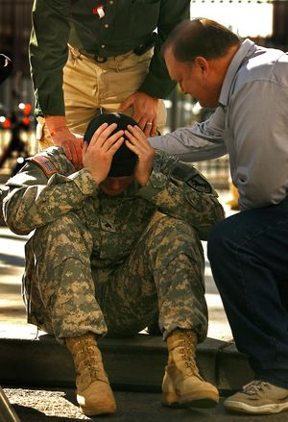
PTSD (Post Traumatic Stress Disorder))
Remembering trauma from
the past
Causes you distress
Nightmares (bad dreams)
Feel like you are reliving
the event

Slide 18

Sometimes people are afraid of what others will think if they seek professional treatment for their mental illness.
We need to make people feel supported and understood - NOT ashamed.

Slide 19
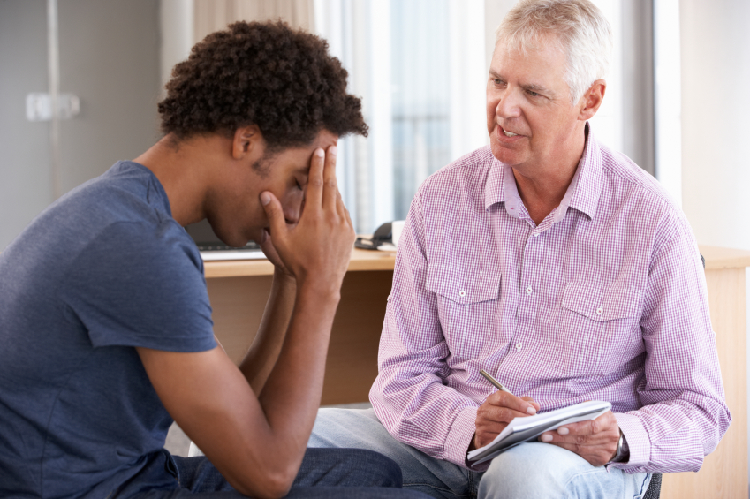
Getting Help
Who to talk to:
Health clinic
Resettlement agency
Teachers / school staff
Treatment:
Talking to a therapist on a regular schedule
Possible prescription for medication
If you are in danger of hurting yourself or others, you may need to stay at the hospital or a group home – not permanently, just while you heal

Slide 20


Sometimes people think they cannot afford to go to a doctor, but there are financial assistance programs available to help people pay if they do not have insurance.

Slide 21

Questions?

