Slide 1
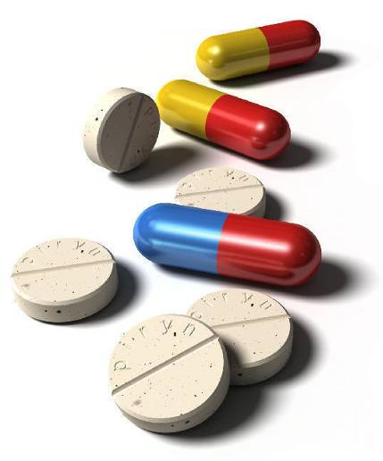
What To Do When You Feel Sick
A Guide for
Newly Arrived
Immigrants
Alana Schriver, Omaha Public Schools

Slide 2
What we will talk about:
What can I treat myself at home?
When do I make a doctor’s appointment?
When should I go to the Emergency Room?
When should I call 911?

Slide 3
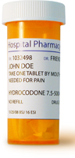
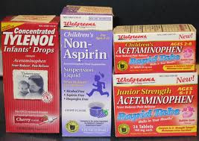
Medicine: What is the difference?
Prescriptions:
Prescriptions are medicine a doctor tells you to take.
This medicine comes directly from the doctor or a pharmacist.
Over-the-Counter (OTC):
You can buy OTC medicine at the
store without a prescription from
your doctor.
OTC medicine is just sitting on shelves at the store.
You do not need to ask a pharmacist for it.

Slide 4
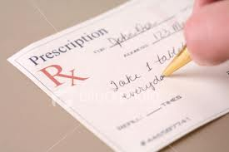
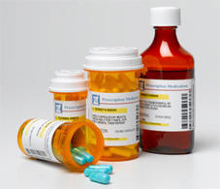
Prescription Medicine
  You should NEVER share your prescriptions with anyone, even if they have the same symptoms. Prescriptions are made special for your own body size and weight.
  Always finish the entire prescription according to the directions, even if you feel better.
  Prescriptions can be paid for with insurance.

Slide 5
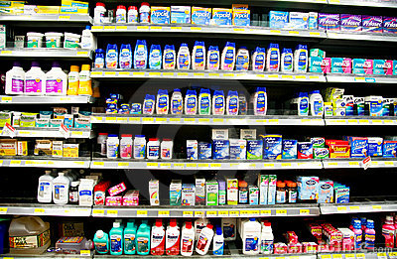
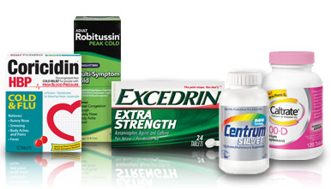
OTC Medicine
  You cannot use insurance for OTCs.
  You will need to pay for OTC medicine yourself.
  Follow the dosage instructions on the box.

Slide 6
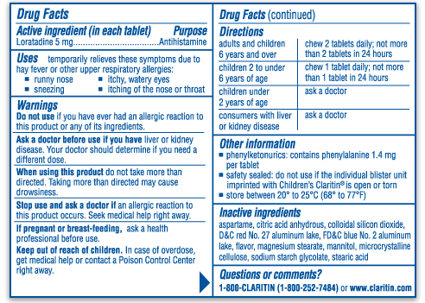
For all medicine, both OTC and prescription, you should always read the label very closely and follow the instructions exactly.

Slide 7
Be careful…
Mixing some medications can be dangerous!
Always tell your doctor what medicines you are taking before starting something new.
For example, some medications cannot be mixed with alcohol, milk, or other items.
Read the label carefully!

Slide 8

Where do I buy OTC medicine?
You can buy OTC medicine many places:
  Walgreens
  Grocery stores
  Gas stations
  If you don’t know what you need, ask a worker for help.

Slide 9

What is the difference?
Name Brand versus Store Brand (Generic)
  Name Brands are more expensive than Generic, but have the same effect.
  You see commercials for Name Brands on TV.
  Generic often does not have a “name” (other than the store’s name), the label may just say what it is for:
  “pain relief” or “cold and flu”
Save Money – Buy Generic!

Slide 10
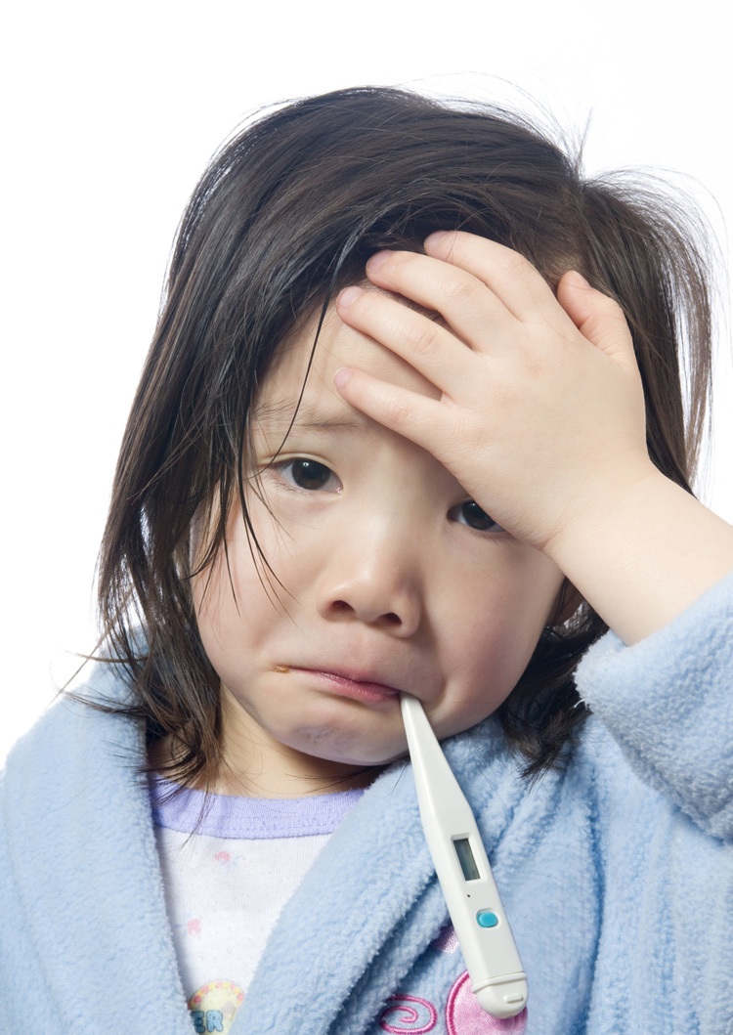
What I can treat at home:
Cold and Flu symptoms
Coughing
Headache and low fever
Body aches and pain
Menstrual period discomfort
Seasonal allergies

Slide 11
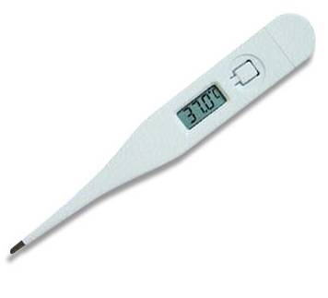
What I can treat at home:
Cold, Flu or Fever
  You should have a thermometer at home to take temperature.
  Anything 100 degrees fahrenheit or higher, call your doctor.
Ask the Yates school nurse to show you how to use a thermometer if you have never used one before.

Slide 12
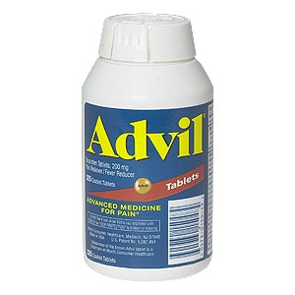
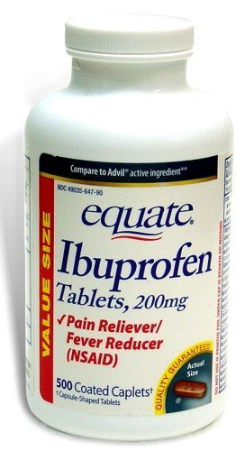
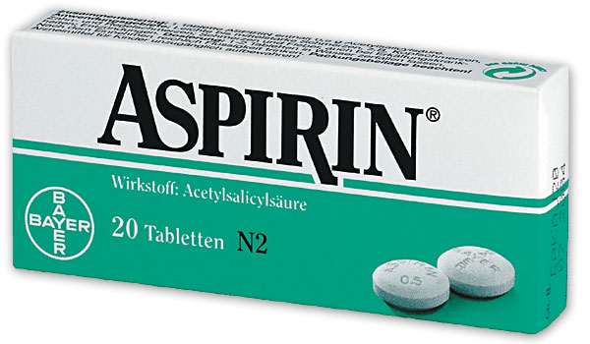
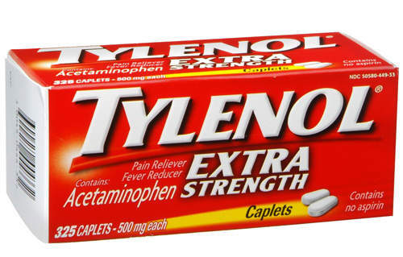
What I can treat at home:
Headache, Pain, and Low Fevers

Slide 13
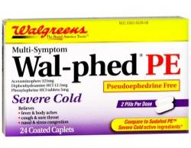
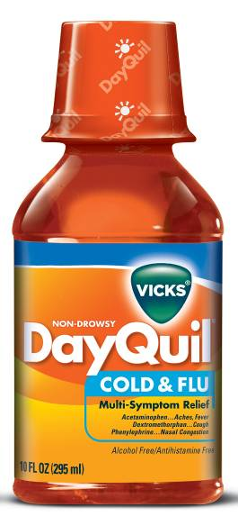
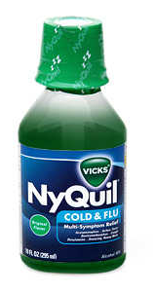
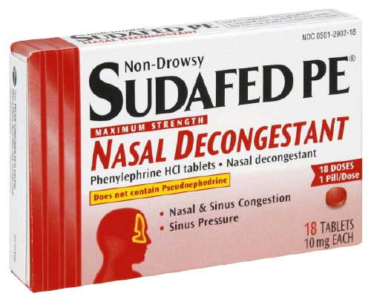
What I can treat at home:
Cold and Flu Symptoms
Nasal decongestant (runny or stuffy nose),
sinus pain, sore throat, cough, body aches
WARNING: Some medicine may make you drowsy (sleepy). Do not take cold medicine if you need to be alert. Do not take night-time medicine during the day.

Slide 14

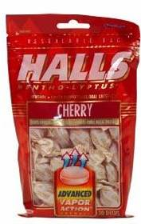
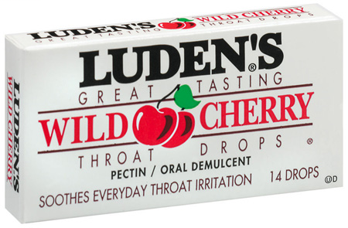
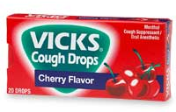
What I can treat at home:
Coughing
Always cover your mouth when you
cough or sneeze so that
you don’t spread germs.

Slide 15
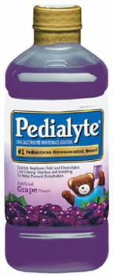
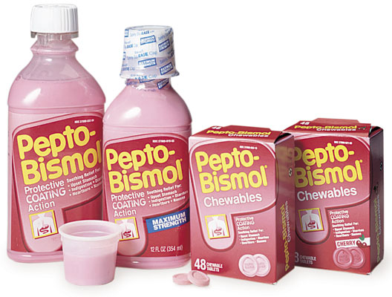
What I can treat at home:
Diarrhea and Vomiting
  Make sure you drink plenty of fluids, like water and fruit juice (NOT soda or energy drinks).

Slide 16
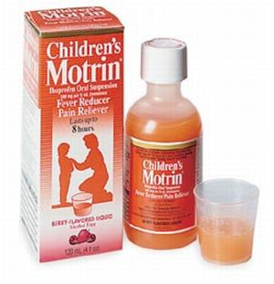
What I can treat at home:
Children’s Cold, Flu or Fever
  If your child is less than 6 months old, NEVER give them any medicine without your doctor’s consent.
  Children should NOT take adult dosages. Always check the label for the proper dosage.
  Look for medicine specifically made
  for children (there is usually
  a picture of a child on the box).

Slide 17
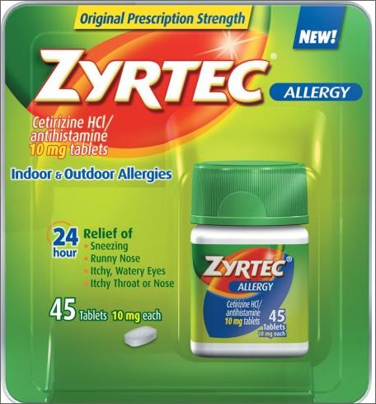
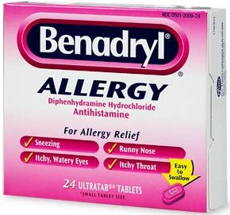
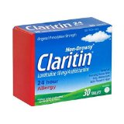
What I can treat at home:
Seasonal Allergies
  Sneezing, itching and watery eyes, scratchy throat

Slide 18
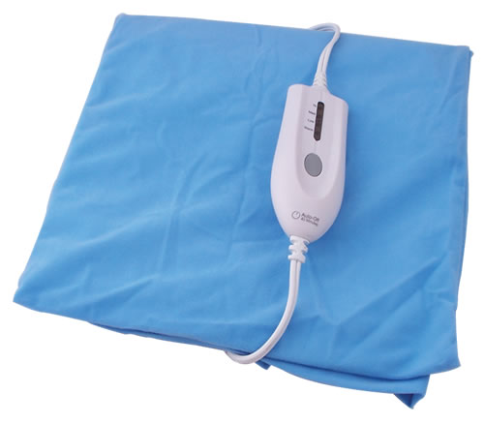
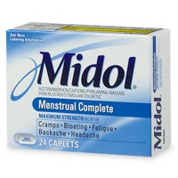
What I can treat at home:
Menstrual Period Discomfort
(Heating Pad)

Slide 19
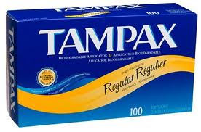
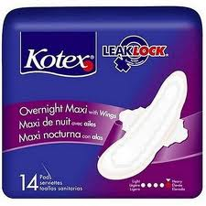
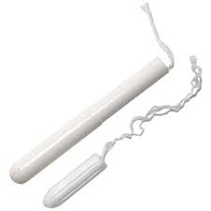
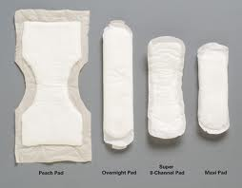
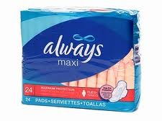
What I can treat at home:
Menstrual Period Flow
Maxi Pads
Tampons

Slide 20
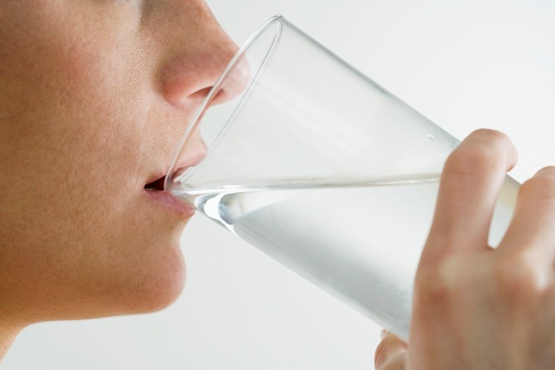
What else can I do to feel better at home?
Drink plenty of fluids to prevent dehydration and help the body cool itself. Water is the best choice.
Make sure you get plenty of rest.
Keep the room temperature at about 70°F to 74°F.
Dress in light comfortable clothing. Overdressing can trap body heat and cause your temperature to rise.

Slide 21
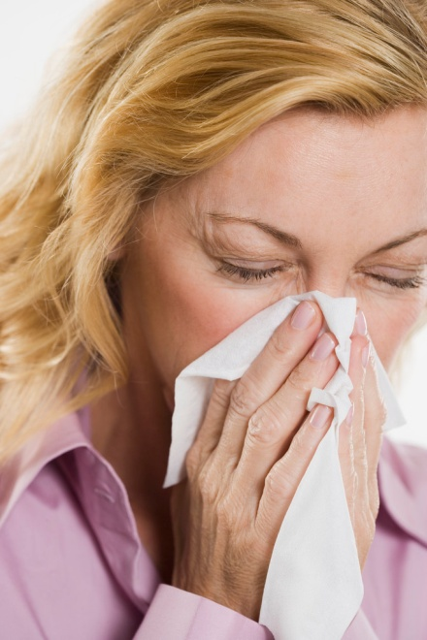
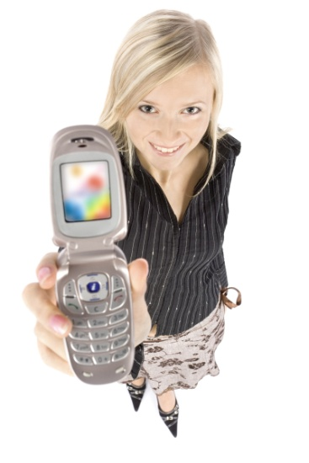
When should I make a Doctor’s appointment?
Call your doctor for any fever 100 degrees or higher.
Phlegm versus snot: snot comes from your nose, phlegm comes from your lungs. If you are coughing up phlegm (thick mucus) from your lungs, you should call and make a doctor’s appointment. Clear snot from your nose is OK; colored snot (green or yellow) means you should see a doctor.
Do not call the doctor about cold or flu symptoms until you have been sick at least one week (unless you have a high fever). If your cold symptoms just started, stay home, rest and drink plenty of fluids. If you are still sick a week later, call and make an appointment with your doctor.

Slide 22
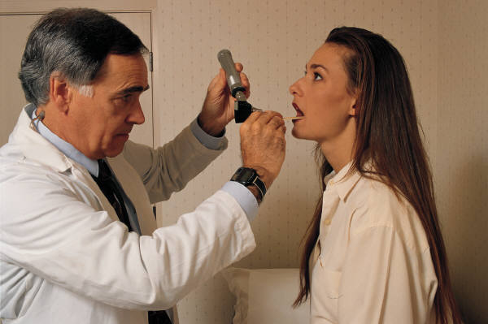
What should I make a doctor’s appointment for?
High blood pressure
Diabetes
Refill prescriptions
Skin rash
Immunizations
Earache
Sexually transmitted diseases
Prenatal care (pregnancy)
Arthritis (pain in joints)
Cold or flu (if sick longer than one week)
Fever
Non-seasonal Allergies

Slide 23
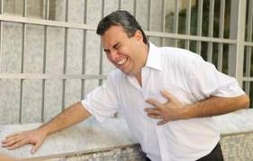
When do I go to the Emergency Room?
Loss of consciousness
Broken bones
Chest pain
Deep cuts and lacerations (severe bleeding)
Head injury
Vomiting blood
Seizures
Difficulty breathing
Acute asthma
Emergency Rooms are open 24 hours a day,
7 days a week.

Slide 24
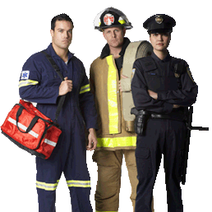
When do I call 911?
911 is for the same types of things you would go to the Emergency Room for, especially if you don’t have a car:
Severe bleeding
Chest pain
Loss of consciousness
Vomiting blood
Seizures
Difficulty breathing
911 Emergencies also include:
Fire
Crime
Car accidents

Slide 25
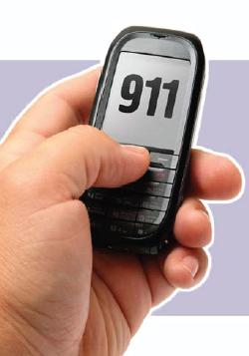
Tips for calling 911
Stay calm
Know where you are
If you don’t speak English,
stay on the phone and repeat
your address
Do not hang up until
the dispatcher says so

Slide 26
Any questions?

