Slide 1

“Let’s Get to Work!”
Employment Readiness Orientation

Slide 2

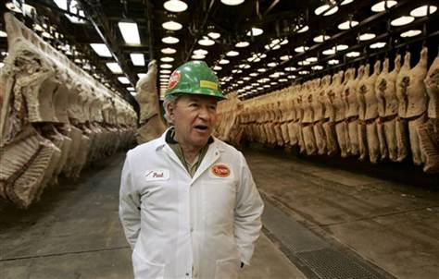


Who Can Work in The US?
U.S. Citizens
Refugees
Permanent Residents
Asylees whose status has been granted
Certain non-immigrant visa holders who have employment authorization

Slide 3


In order to be legally employed in the United States, you are required to present documentation to your employer to show evidence of your authorization to work.
Everyone who works in the United States needs to show their employer a social security card.
OK
Restricted

Slide 4
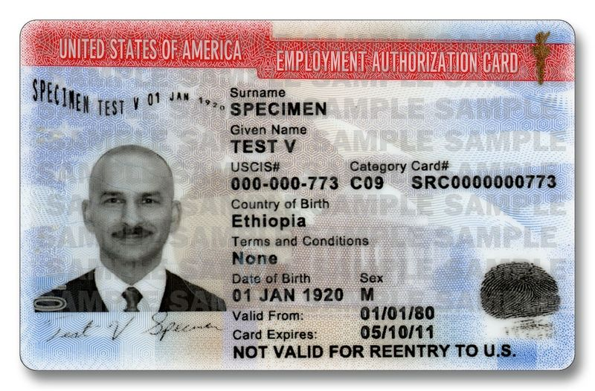
If your social security card is restricted, you may need an Employment Authorization Card (EAD).

Slide 5
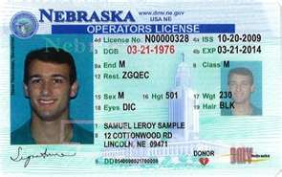

All Refugees are LEGALLY ELIGIBLE to work in the United States from the day they arrive.
Your I-94 has a stamp that says you are employment authorized.
Refugees do not need an EAD card to work.
Do not pay for a new EAD if yours expires.
You will need a STATE ID and a SOCIAL SECURITY CARD.

Slide 6
American Workplace Culture
All employers have certain behavior and
dress expectations of their workers.
Different jobs may have different dress codes and rules that they will go over with you once you are hired.
But there are Cultural Expectations that apply to
every job in America…

Slide 7

Number 1 Rule: Be On Time!!!!
In fact, try to be a little early.

Slide 8

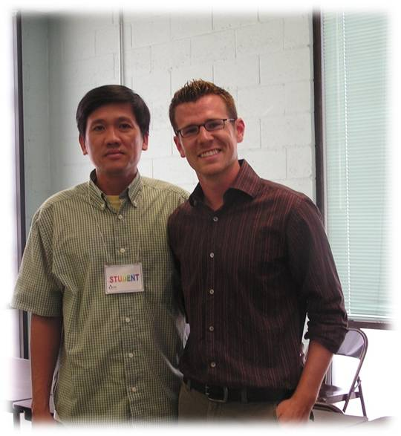



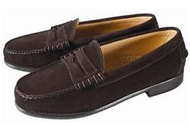
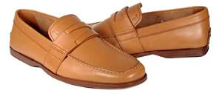
Wear Clean Clothes
Use Deodorant
Wear shoes & socks

Slide 9

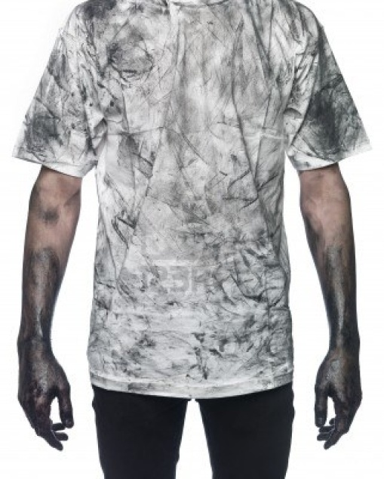

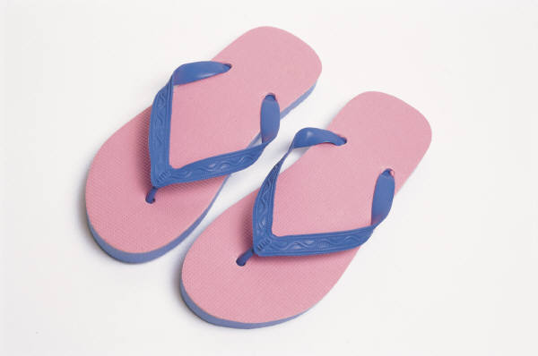

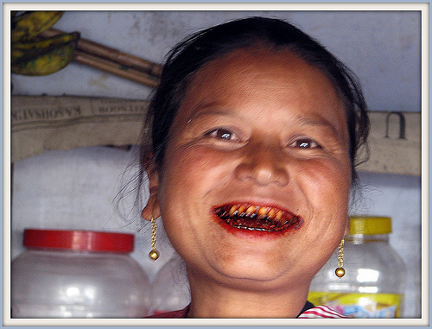

No Thanaka
No Dirty, Smelly Clothes
No Sandals
What NOT to do at work...
No Smoking
No Betelnut

Slide 10

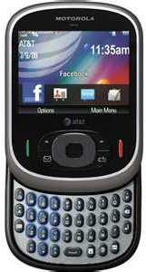
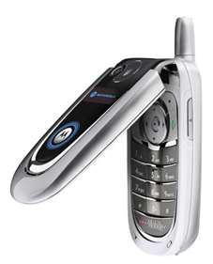
Turn your phone OFF or to SILENT at work!
DO NOT use your cell phone while you are at work
(unless you are on break and the boss says it’s ok)
NEVER answer your phone during an interview or meeting.

Slide 11



DRUGS AND ALCOHOL
In America you may be required to take a drug test before you are hired.
DO NOT drink alcohol or do drugs while you are looking for a job!
- DO NOT drink alcohol or do drugs before you go or while you are at work!

Slide 12


Restroom / Bathroom
Women – sit on the toilet; do not squat
Clean up after yourself
Wash your hands

Slide 13

Searching for a Job
Talk to your friends who work
  Is their job hiring?
Newspapers
Walk in and Ask
The Internet / Online
  www.careerlink.com
  Employer’s website
  NE Workforce Development

Slide 14
What types of jobs should you look for?
What do you want to do?
What time shifts do you want to work?
What experience do you have?
Read the QUALIFICATIONS section carefully.
- Do you meet the requirements?
- Is the job “entry level” or “advanced”?

Slide 15
Applying for a Job
When you find a job you want, you must fill out a job APPLICATION.
There are two types of applications:
Paper Application
Online Application

Slide 16
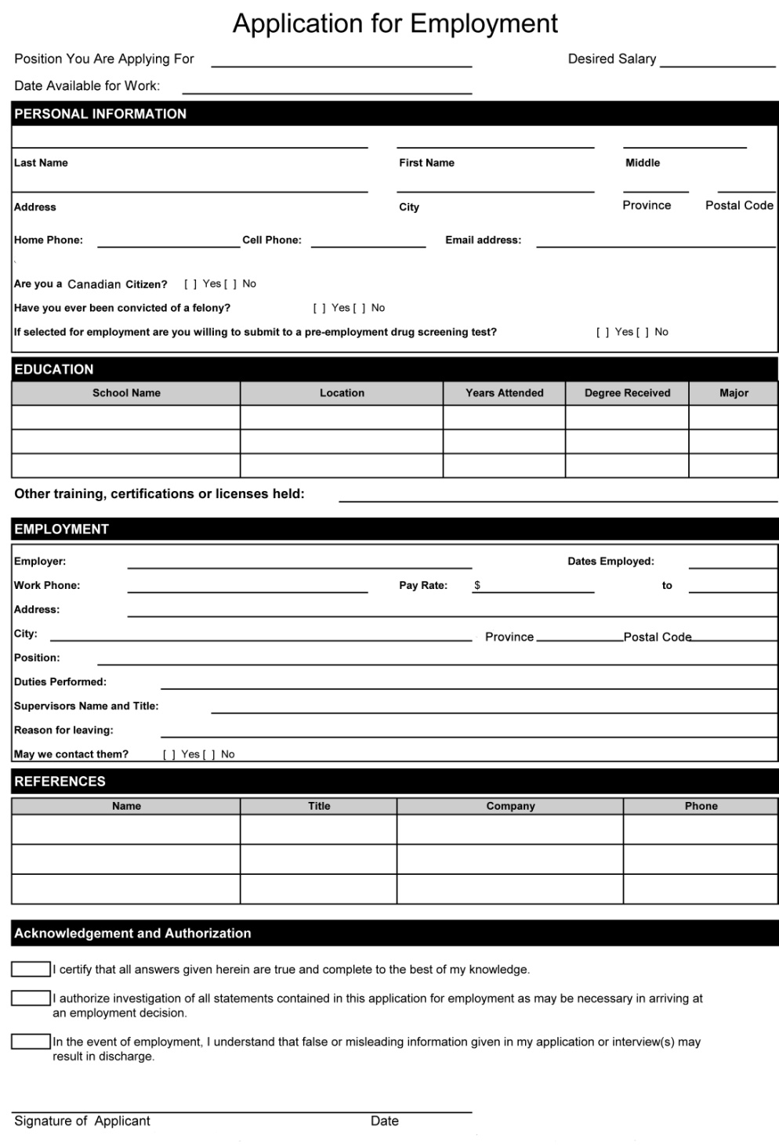
Job Applications
Applications ask you for personal information, as well as questions related to the job.
An application tells the company whether or not you qualify for the job based upon your Experience, Skills, and Education.
Employers compare all the applications they receive and decide which applicant is the best candidate for the job.

Slide 17
Resume
A Resume is a list of your previous jobs, education and special skills.
Not everyone will need a resume; it depends upon the type of job.
Make sure your name and contact information stand out at the top.
Resumes are usually only one page.
It is an opportunity to “sell yourself” = brag about yourself
– for example: how many languages do you speak?
Keep a copy of your resume with you when you are applying for jobs, that way you have the information needed to complete applications.

Slide 18
Bee Htoo
1124 Brown Street, Omaha, NE 68949
402.536.3500, beehtoo@gmail.com
Experience:
Instructor & Pastor, Karen Baptist Bible College 06/2001 – 7/2009
-Taught Rural Mission Course to Bible College Students
-Student Mentor
-Organize Meetings and Events
-Supervise Bible College store
Thai Tomato Company, Chaingmai, Thailand 6/1994 - 8/1995
-Checked for quality as machines filled each jar with tomato sauce
-Fastened lids to jars, put jars into boxes for shipping
-Loaded truck with boxes based on each order
Education:
Karen High School No. 1 Graduated 1998
Contact Information
Jobs in refugee camp or in United States
Dates are important!
High School, Training, Languages

Slide 19
When Applying for Jobs…
Make sure you have a professional voicemail:
- In English
- Not too long
If you share a phone, make sure others speak English
- and give you the message!
Keep pen and paper by phone
  - Write down who, where, when

Slide 20
The Interview

Slide 21



Greet your interviewer with a smile and a handshake.
(Doesn’t matter if they are
Male, Female, Older, Younger)

Slide 22




Be at least 15 minutes early!!!!
Make sure you know where you are going ahead of time so you are not late.

Slide 23




SMILE
SMILE
SMILE

Slide 24
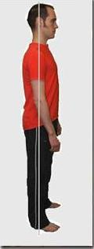





Stand and sit up straight during interview.

Slide 25



Make Eye Contact!
Male, female, older, younger – make eye contact with EVERYONE

Slide 26




Interview & Orientation Etiquette
Do NOT...
Spit
Take off your shoes
Pick at your nose, ears or face

Slide 27
Interpreters
Different Employers have different rules for interpreting.
- Some may allow you to bring your own interpreter
Some may provide a
company interpreter
- Some do not allow interpreting at all; you must interview in English

Slide 28
Listen carefully to all questions
??????
If you do not understand, ask the person to say the question again.

Slide 29
“I’m sorry, I do not understand. Could you repeat the question?”
“Can you repeat that in another way?”
“Sorry, I’m not sure what you mean. Can you please explain?”

Slide 30

Close the interview by THANKING your interviewer and saying GOODBYE.
Thank you for your time. Goodbye.

Slide 31
Practice Interview
>Hello, my name is _____, welcome to our company.
>>Hello, my name is _____.
>Hello. How are you today?
>>I am fine, thank you.
>Please sit down. Tell me more about yourself.
>>I am a hard worker. I will always come to work on time.
>Do you have any experience?
>>Yes, I worked as a farmer in Burma.
>>Yes, I used to be a teacher in Nepal.
>>Yes, I was a health volunteer in the refugee camp.

Slide 32
Practice Interview
>When can you begin working?
>>I can start anytime. I can work everyday!
>Thank you for coming today. Do you have any questions?
>>Yes, when will you make a decision about the job? What shift would I work?
>We will contact you in one week. Thank you very much.
>>Thank you for the interview. Have a nice day.
>Goodbye!
>>Goodbye!

Slide 33

You’re Hired!!!
Arrange childcare for your children
Have a transportation plan
Be on time to work each day
Dress appropriately for the job
  Example: Tyson: wear warm clothes and good shoes

Slide 34
“Calling In” to Work
If something happens (car trouble, sick child) and you cannot go to work or you will be late, you MUST CALL and tell them.
Call them as soon as you know you are having problems. Do not wait.
Do not “no call no show” – you can lose your job

Slide 35
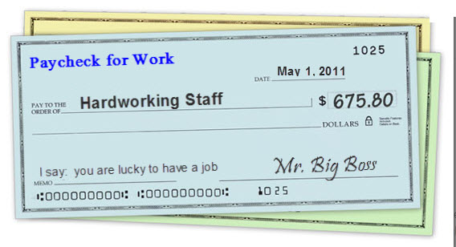
When you get a job...
-Tell DHHS right away
-Tell Resettlement Agency
Give a copy of your first paycheck to your caseworker and/or DHHS

Slide 36
Quitting a Job
If you need or want to quit a job,
DO NOT JUST STOP GOING TO WORK!
Always give 2 weeks notice to your supervisor.
When you apply for a new job, they may call your last employer – you want them to say nice things about you.
Try to keep each job for AT LEAST 6 months.
Do not quit unless you have another job lined up.

Slide 37


GOOD LUCK!!!
Finding a job is not easy.
Work hard and never give up!

Slide 38


Questions

