Slide 1
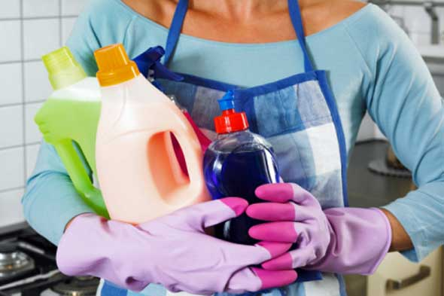
How to Keep Your Home Clean and Bug-Free
Alana Schriver, Omaha Public Schools

Slide 2
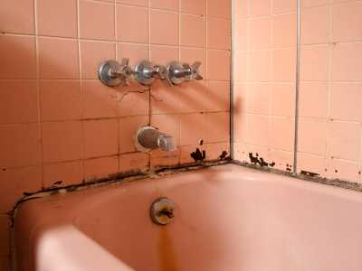
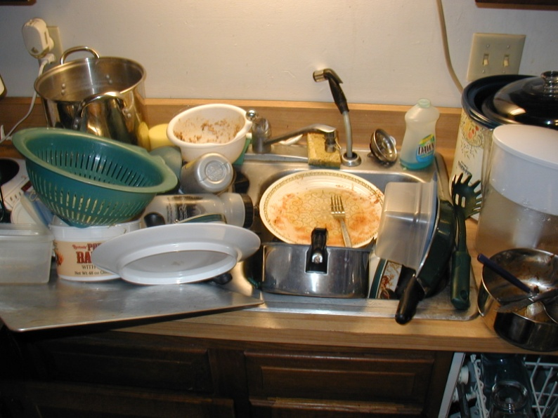
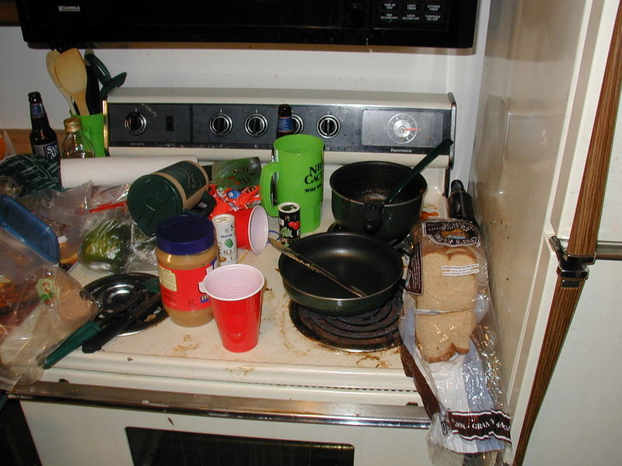
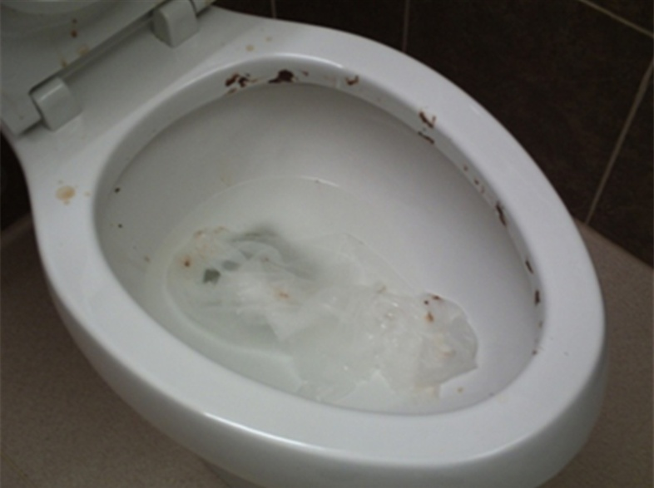
A Dirty Home is Not Healthy!
NO!
Not Good

Slide 3
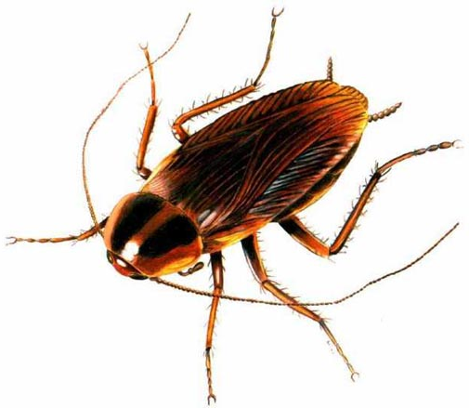
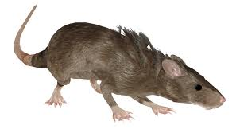
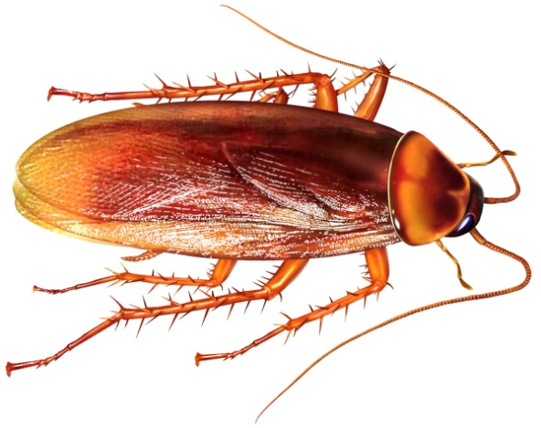
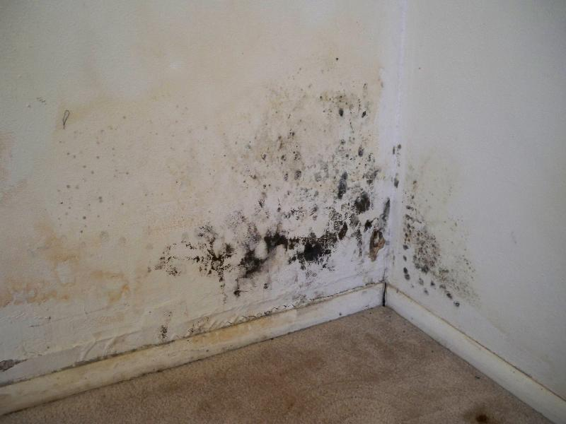
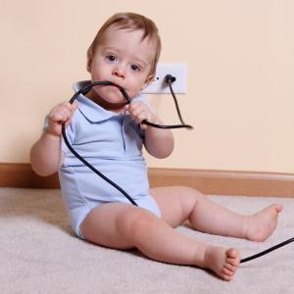
Dirty homes attract bugs and pests.
Mold can make you sick.
Children can get hurt.

Slide 4
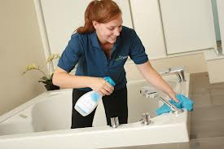
Having a clean home feels good!

Slide 5
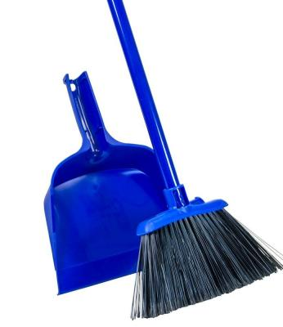
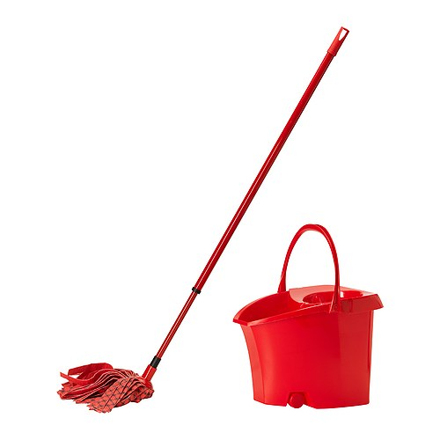
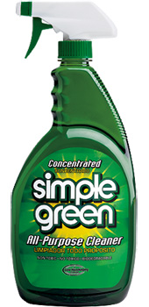
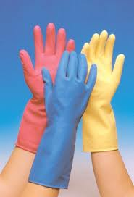
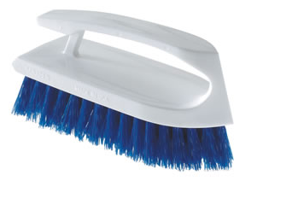
What Do I Need?
Broom &
Dustpan
Mop & Bucket
Rubber Gloves
Cleaners
Scrub Brushes

Slide 6
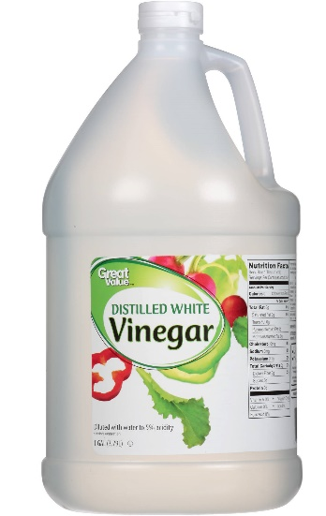
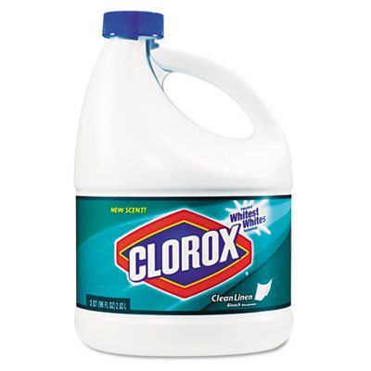
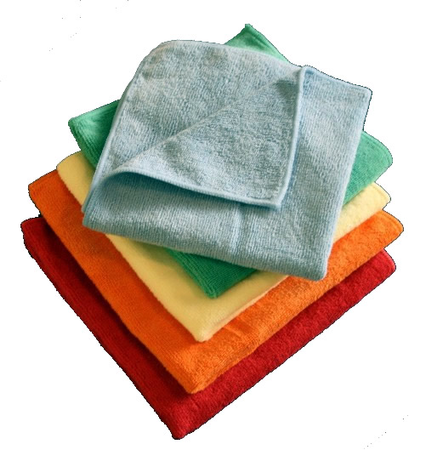
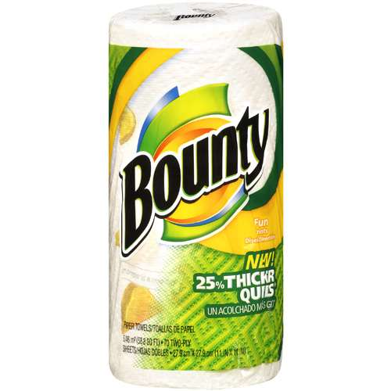
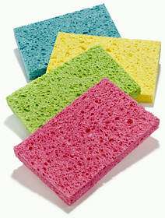
What Do I Need?
Vinegar
Amonia
Bleach
Paper Towels
Sponges
Rags

Slide 7
IMPORTANT!
Cleaning supplies can be poisonous.
You need to keep them out of reach of children!
Keep them up high or in a locked cabinet.
If your child eats or drink one,
Call Poison Control:
1-800-222-1222

Slide 8
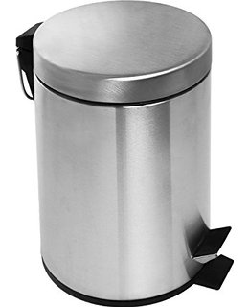
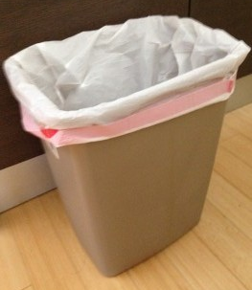
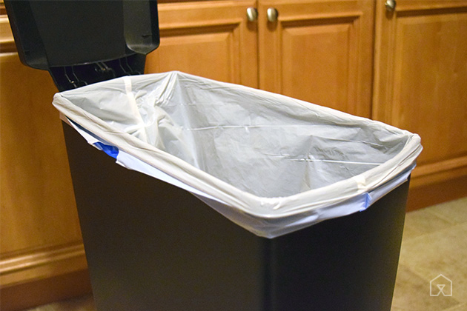
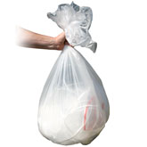
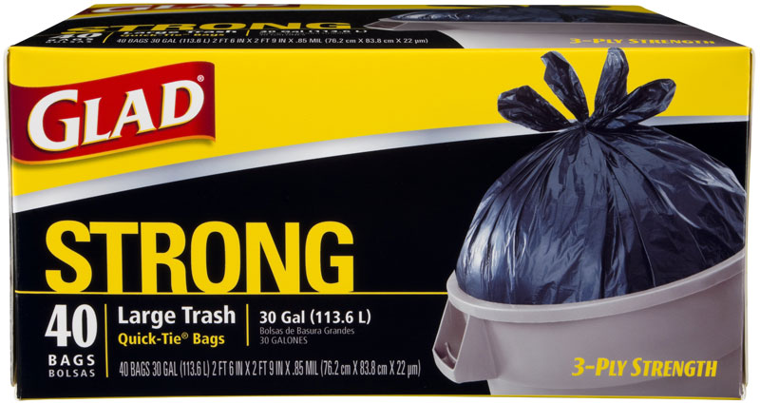
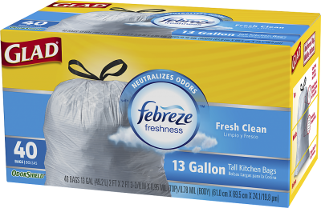
Trash Disposal
You need to use trash cans inside your home.
You will need to buy and use trash bags.

Slide 9
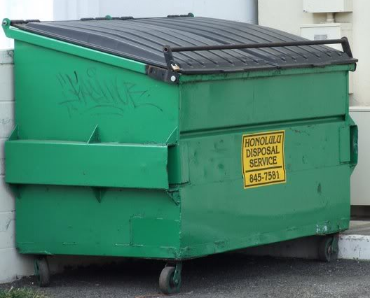
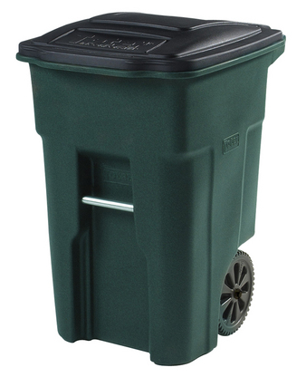
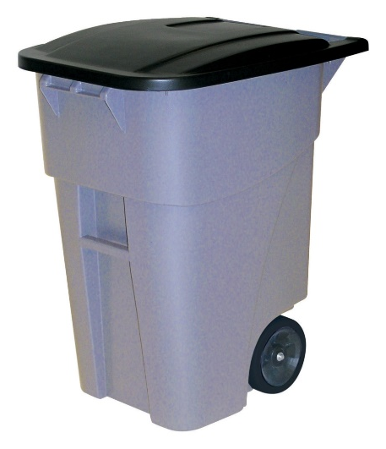
Trash Disposal
Apartment Complex
House
When your trash bag is full, pull it out of the trash can carefully and tie it closed.
Place it inside the dumpster outside.
You may need to purchase bins with lids for outside.
When your trash bag is full, place it in outside bin.
Put the outside bin on the curb on your weekly trash collection date.

Slide 10
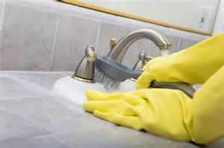
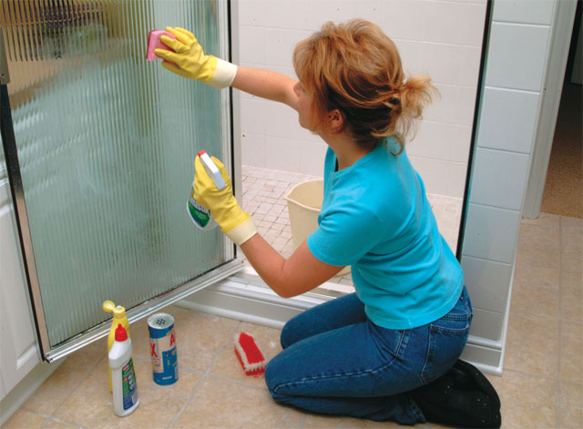
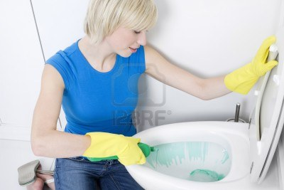
Bathroom
Keeping your bathroom clean will prevent MOLD
Clean the bathroom at least once every week!

Slide 11
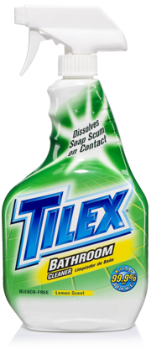
Bathroom Cleaners
(for the sink and shower)
Look for the words “bathroom cleaner” on the bottle.
Spray the surface you want to clean, then wipe with a sponge or clean rag.
For tough spots, you may need to scrub with a brush.

Slide 12
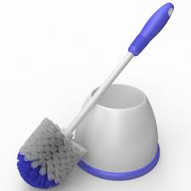
Bathroom Cleaner
(for the toilet)
Keep your toilet brush separate from all other scrub brushes!
Squirt the toilet cleaner around the rim, wait a minute, then scrub with a brush. Flush when you are finished.

Slide 13
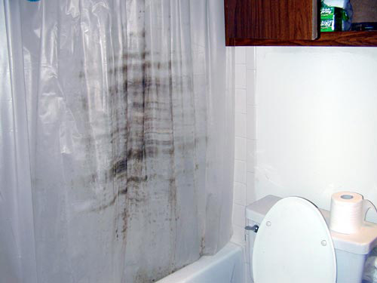
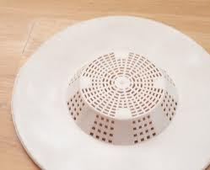
Bathroom
If your shower curtain is moldy, throw it out
and get a new one.
If your bathtub does not have a drain cover, buy one.
This will prevent hair from clogging your drain.
You can buy both of these items at
Family Dollar or Walmart.
They are not expensive.

Slide 14
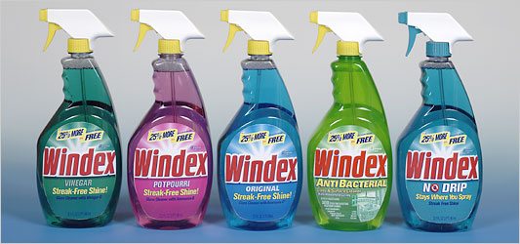
Glass, Windows, and Mirrors
Look for
“glass cleaner”
on the bottle.
Spray the glass with the cleaner, then wipe with a clean rag or paper towel.
Vinegar water will also clean glass!

Slide 15
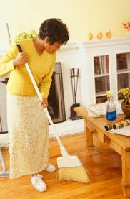
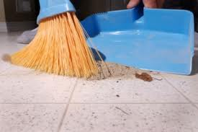
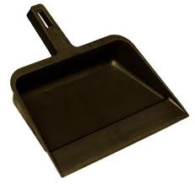
Floors
Shake rugs outside.
Sweep the dirt out from under furniture and rugs.
- Sweep crumbs out from under the stove and refrigerator – food crumbs bring bugs and mice!
- Sweep all of the dirt into a pile with your broom.
- Sweep the pile into the dust pan.
- Empty the dust pan into the trash.
Do not just sweep the dirt outside.
Broom
Dust pan

Slide 16
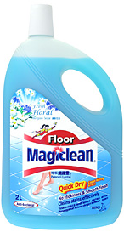
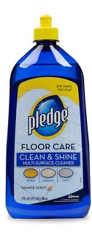
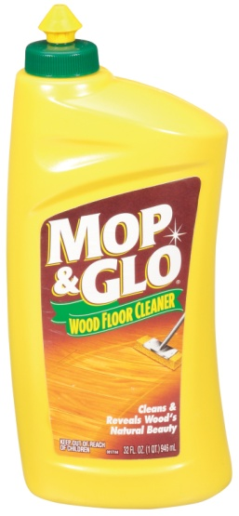
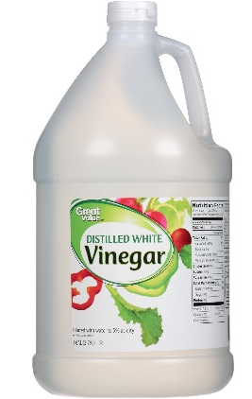
Floors (Wood, Linoleum or Tile – NOT Carpet)
Fill a bucket with warm water.
Add cleaner.
Dip the mop in the bucket and
get it wet and soapy.
Wring out the excess water!
Rinse your mop frequently in the bucket.
Mops
Cleaners
Look for the words “floor cleaner” on the bottle.
Vinegar also works.
Bucket

Slide 17
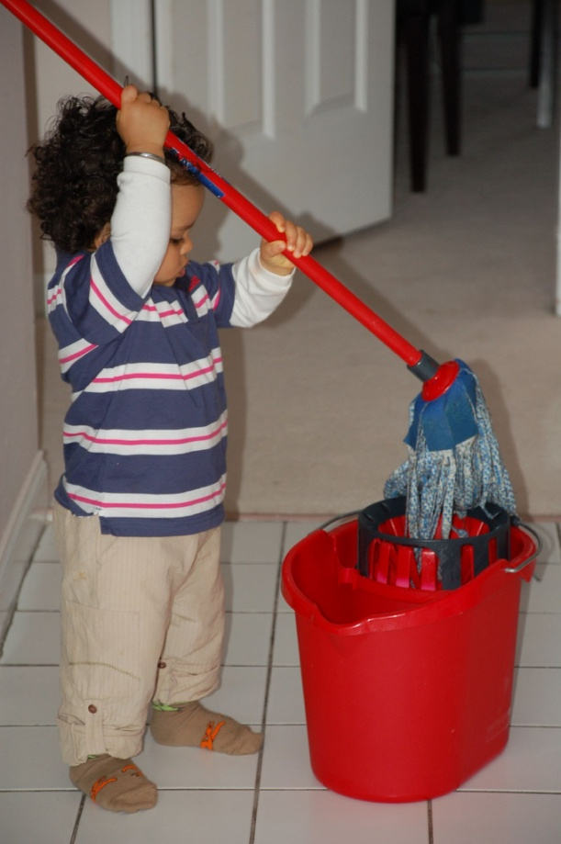
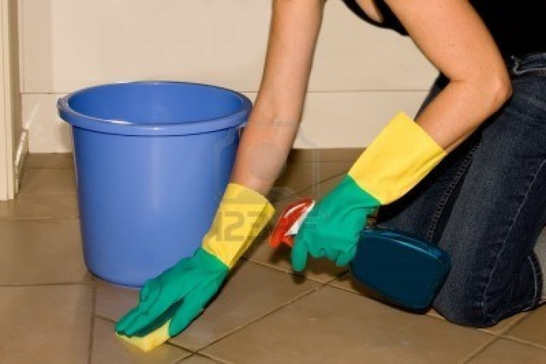
Floors (Hardwood or Linoleum – NOT Carpet)
Mop your floors at least once every week.
If you spill something, clean it right away!
Do not wait.
Some tough spots may require scrubbing by hand.
Don’t use too much water…

Slide 18
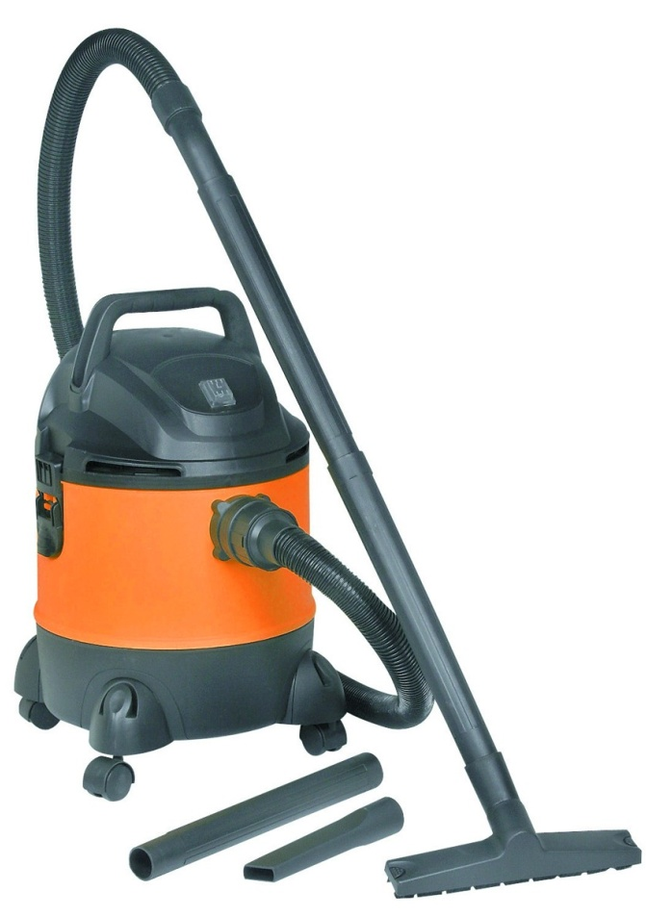
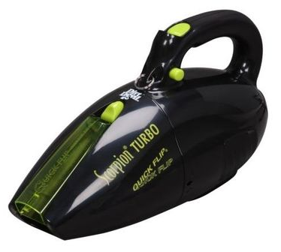
Carpet
Push Vacuums
Hand Vacuums

Slide 19
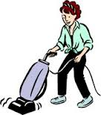
Vacuuming
Pick up or sweep large or hard pieces off the floor before vacuuming.
You can break the vacuum if you run over large pieces.
String / hair can get tangled inside the vacuum and need to be cut out.
Hold the cord up so you do not run over it.
Vacuuming can help kill bed bugs!
Bed bugs lay eggs in the carpet so make sure you vacuum the entire room.
Vacuum under furniture and in the corners.

Slide 20
Vacuuming
Vacuums with a HOSE are best.
You can clean difficult to reach areas with a hose.
It is very important to vacuum under the cushions and in the creases of your furniture.
Bed bugs lay eggs in these creases.

Slide 21
Vacuuming
Vacuum regularly –
at least twice every week.
Empty the dirt bin of the vacuum when you finish.
If your home has bed bugs, dispose of the dirt OUTSIDE to get ride of the eggs.
Please do not just dump the dirt in a pile outside, put it in the dumpster.

Slide 22
Kitchen
Bacteria from uncooked foods can make you sick.
Cleaning immediately after cooking can help keep you healthy.
It is important to clean the entire surface, not just the dirty spots. You cannot see bacteria.

Slide 23
Kitchen
“All-Purpose” Cleaners
Spray the cleaner on the counter, stove top, or inside the fridge,
wait a minute,
then wipe with a paper towel.
Use a paper towel so that you can throw it away when finished.

Slide 24
Sink Drains
Do not put food or cooking oil down your sink drain!
Empty dishes into trash can before washing them in the sink.
Food, even small pieces, will clog your drain.

Slide 25
Sink Drains
Always keep a strainer in your sink. You can buy a strainer at Walmart or the Dollar Store.
Do NOT allow food pieces to go down the drain. Catch them in the strainer and dispose in the trash.
Do NOT put cooking oil or grease down the sink.
Food and Grease will eventually clog your pipes and you will be responsible for the cost to fix it.
X

Slide 26
Proper Food Storage
Food that is not stored properly will attract bugs and mice.
Food must be in air-tight containers so that pests cannot smell it.
ALWAYS keep food in the fridge,
in tupperware,
Or in sealed ziploc bags.

Slide 27
Proper Food Storage
Big bags of rice should be stored in metal bins with tight lids to prevent mice and rats.

Slide 28
Proper Food Storage
X
X
These will NOT keep bugs out of your home.
Pests can still smell the food through the holes and will come into your home to find it.
Yes!
They are meant to keep flies off of food outside.
They are NOT for indoor use.

Slide 29
It is very important to keep your home clean.
Everyone in the family should help keep things clean.
Your home should NOT have bugs, mice, or mold.
If you do not know how to clean something,
it is ok to ask for help.

Slide 30
Any Questions?

