Slide 1
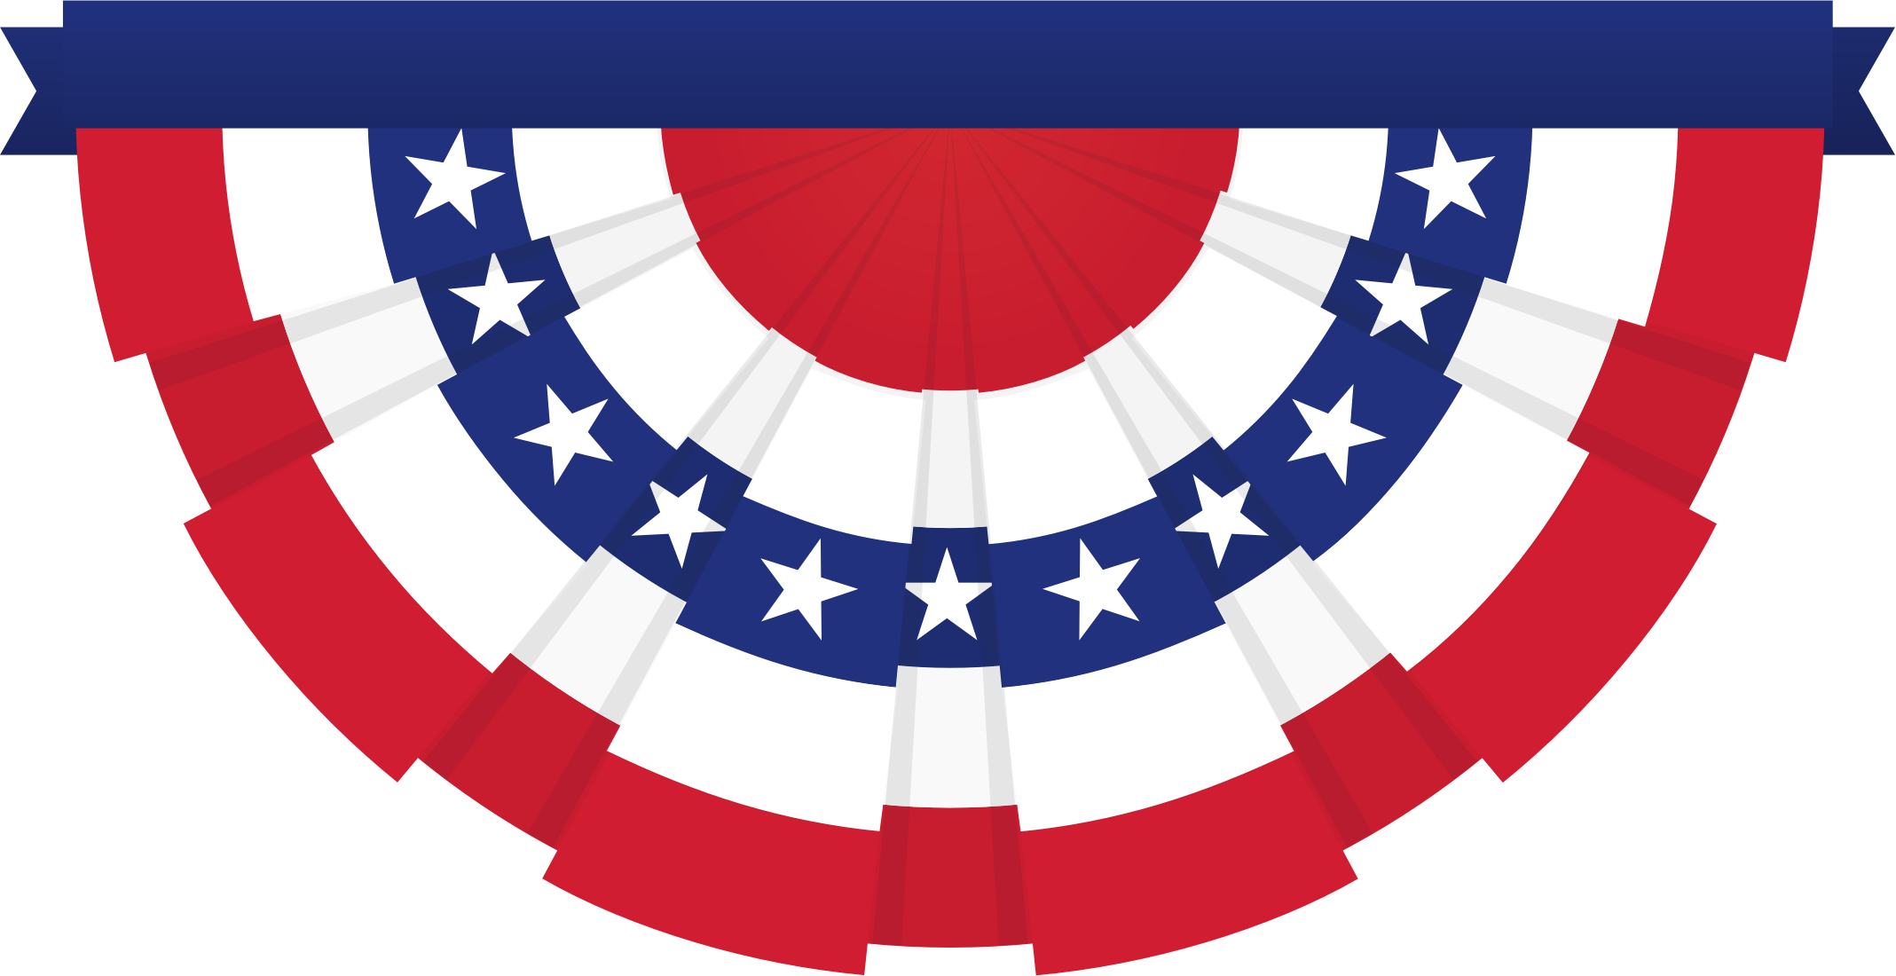
American Values and Communication Styles
Omaha Public Schools / Yates ECP
Compiled from tips via The Refugee Center Online
2018

Slide 2
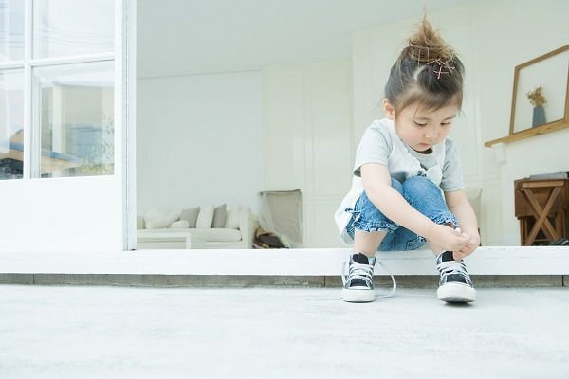
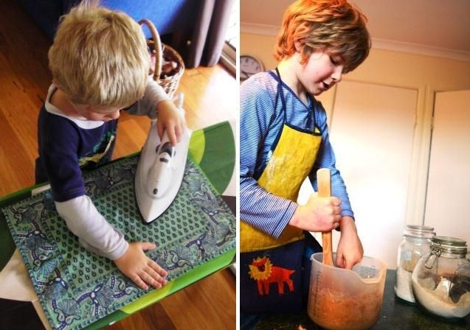
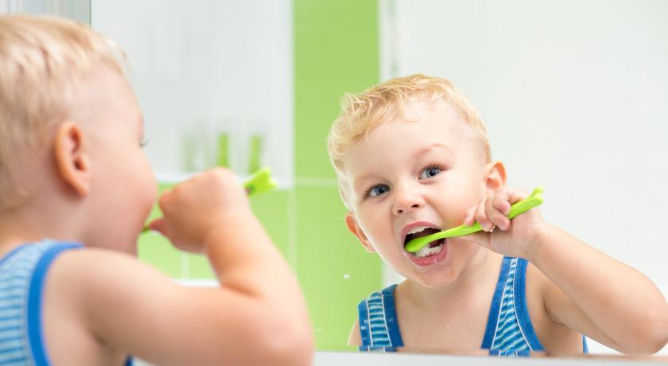
Independence
Independence is sometimes referred to as individualism.
Americans are very proud of being self-reliant (being able to take care of themselves) and think others should be self-reliant as well.
When someone reaches a goal, that is typically seen as the result of his or her own hard work. This is different than in cultures which are more collective (collective cultures tend to see accomplishments as a reflection of an entire family or community).
American children tend to leave the home earlier than in other cultures. After graduating high school, many children move out to go to college or start working. If they continued to live at home, they might be asked to pay rent or contribute to the house.

Slide 3
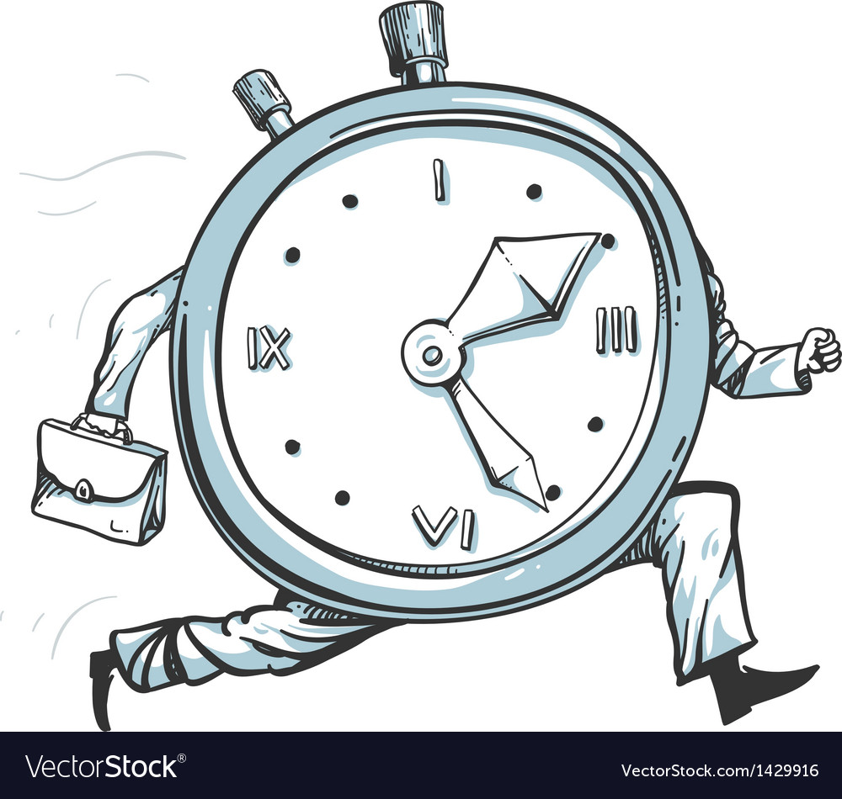
Time and Efficiency
Americans place a lot of value on their time.
There is a saying in America: Time is money.
Americans may feel upset if they think someone/something has wasted their time.
Americans often use daily calendars for both their personal lives and their work lives.
For business meetings and official appointments, it is a good idea to arrive 15 minutes early.
If you are invited to an America friend’s home, call and let them know if you will be more than 10 minutes late. If you can’t call ahead of time, apologize when you arrive.

Slide 4
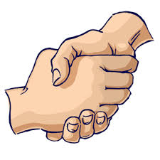
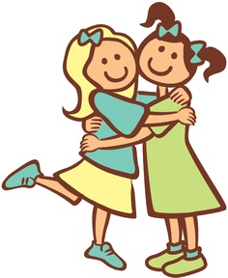
Touch
Most Americans shake their right hands firmly when they meet.
If you feel uncomfortable shaking hands, you can excuse yourself by placing your hand over your heart instead.
Americans may hug each other if they already know each other.
“Holding hands” usually indicates a romantic relationship.

Slide 5
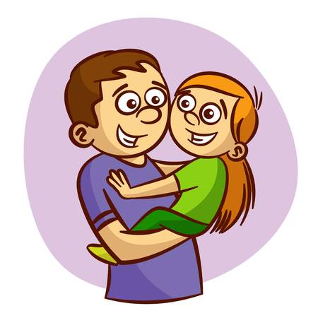
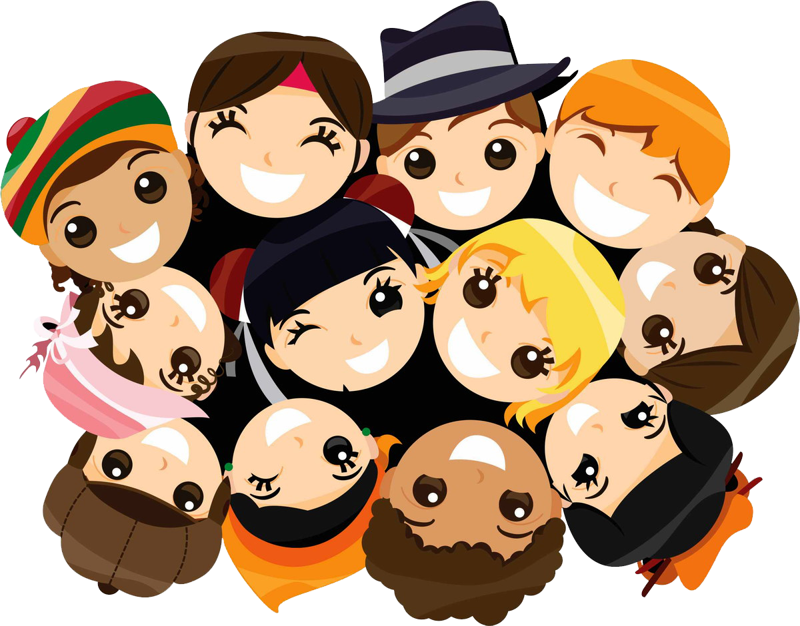
Smiling
Americans smile a lot to show they are happy and to be polite.
When you meet someone new, Americans expect you to smile at them.

Slide 6
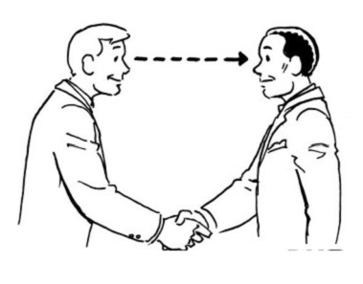
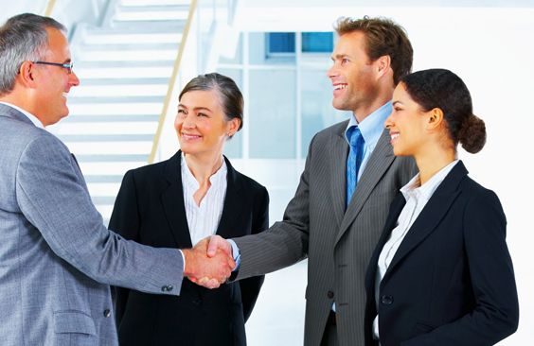
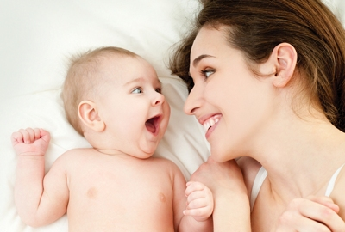
Eye Contact
Most Americans make eye contact during conversations.
If you do not make eye contact, people may think you are not interested in them or maybe even lying.
People who look directly into your eyes are often viewed as more trustworthy, intelligent, and kind by Americans.
Eye contact is very important at job interviews!
If you come from a culture where people do not look into each other’s eyes, this may be very hard for you.

Slide 7
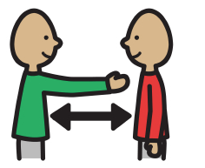
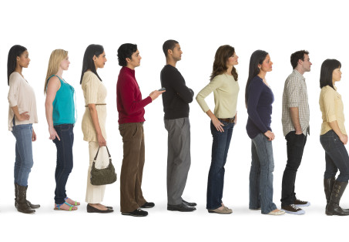
Personal Space
Americans like to have “personal space” around them, even in a crowded area or waiting line.
This means if you are talking to someone, they will probably stand at least arm’s length away from you.
Talk to your children about respecting personal space with their friends at school. Children are expected to “keep their hands to themselves” at school.

Slide 8
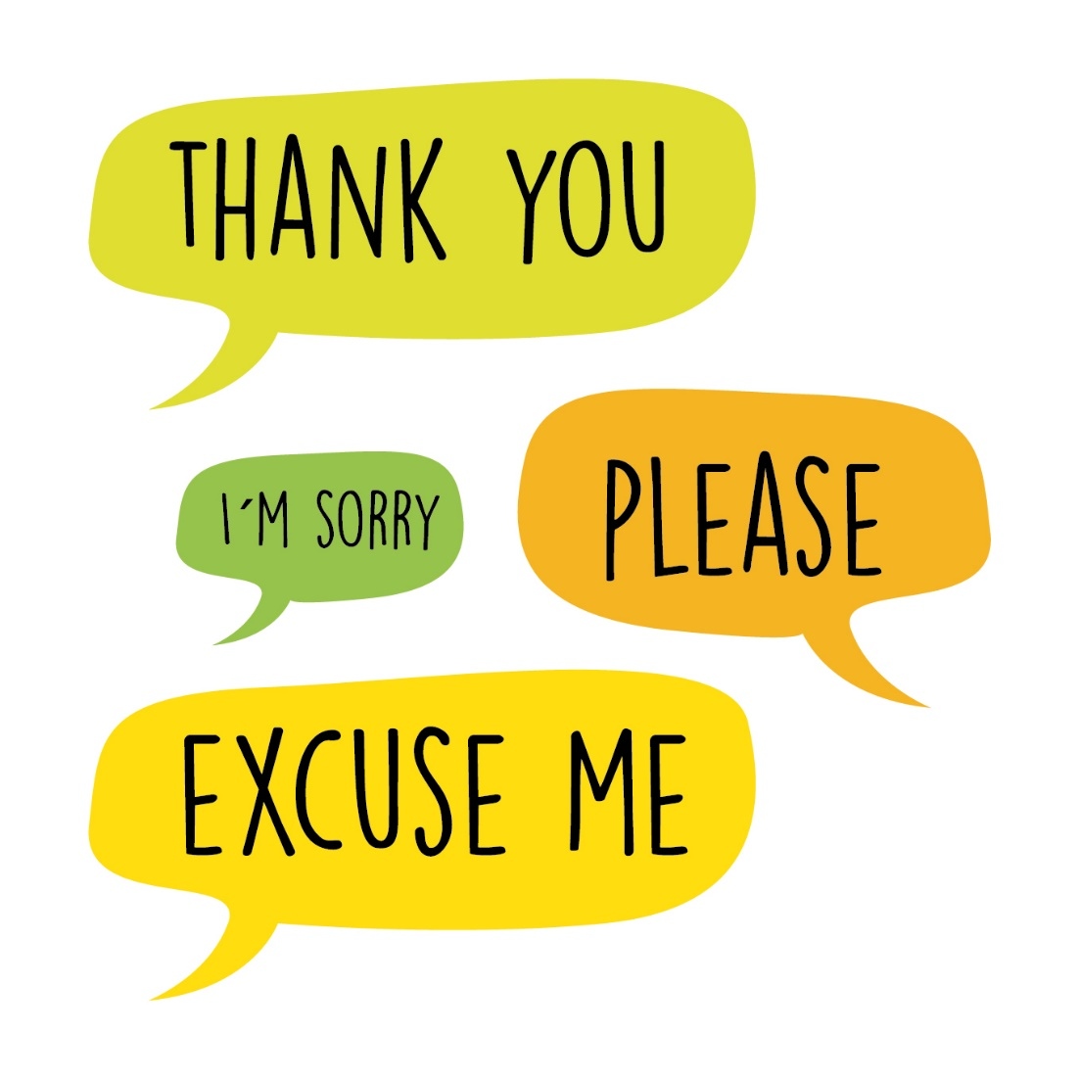
Manners
Americans say “please” when they ask for something.
They say “thank you” when they receive something or someone helps them. Americans tend to thank others even for little things.
For example: If someone holds a door open for you, it is polite to say thank you.
Americans say, “I’m sorry” or “excuse me” if they bump into one another accidentally. “Excuse me” is also used to pass by someone, interrupt a conversation, or leave a conversation.

Slide 9
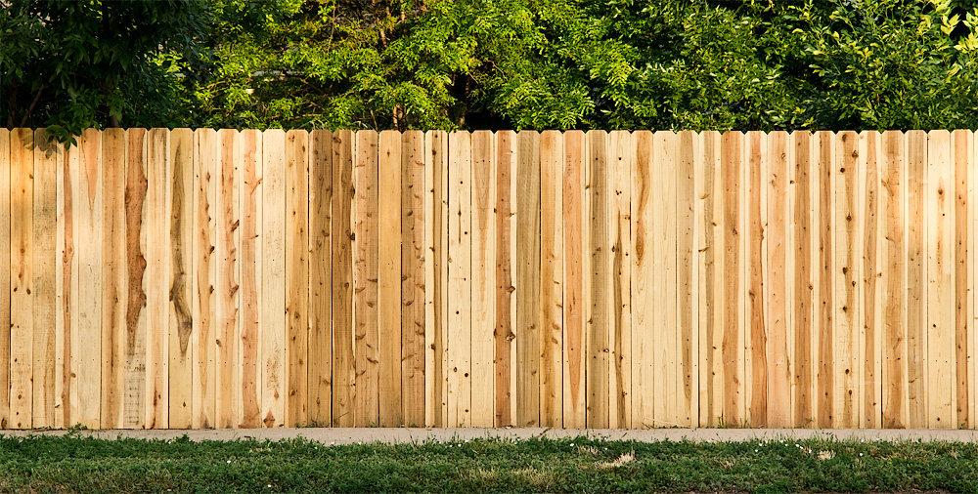
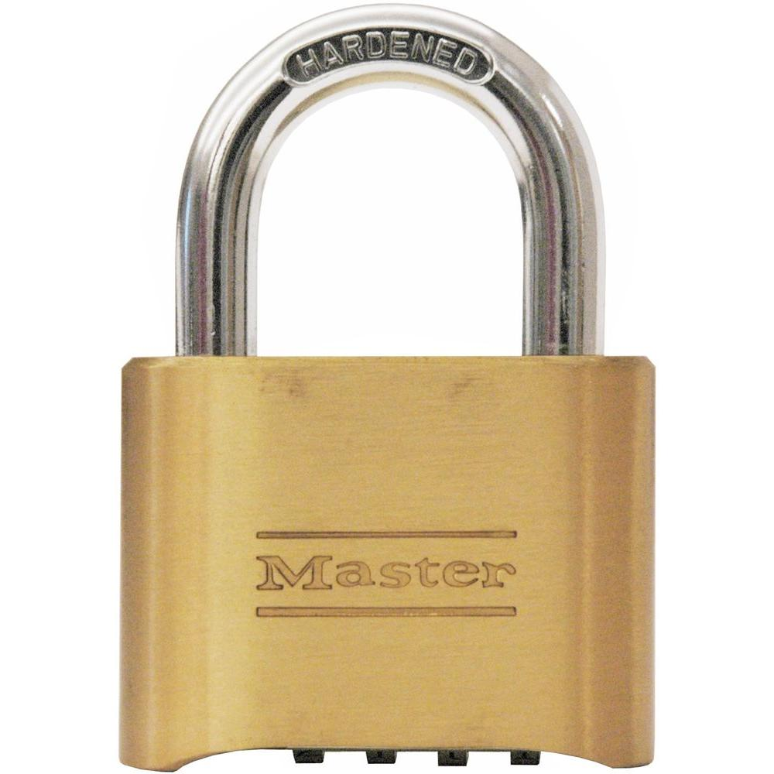
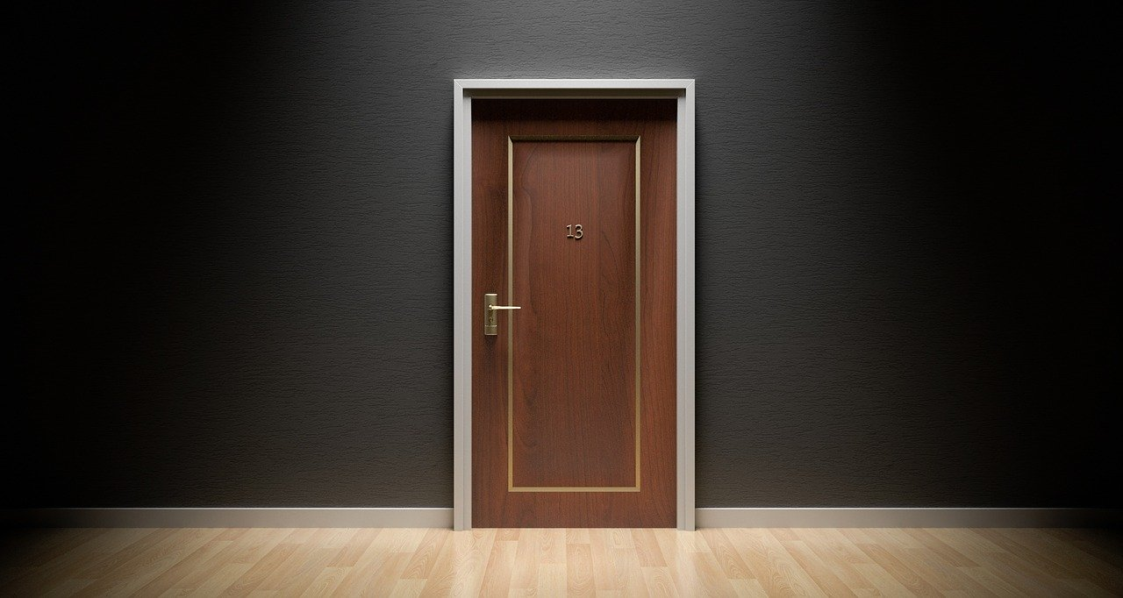
Privacy
While in some cultures wanting privacy may be seen as a bad thing, many Americans like to have alone time and may be private about certain topics.
Property lines; privacy fences
Bedrooms are usually considered private spaces. Neighbors and friends are entertained in the kitchen, dining room or living room. Parents and children tend to have their own bedrooms.

Slide 10
Directness
Americans will tell you what they think and are assertive about what they want.
Being assertive is generally seen as a good thing in America.
For example:
In some cultures, it is rude to decline an invitation – like, if someone asks you for lunch, you may say yes, but then not go. In America, it is almost always better to say, “No, but thank you” or, “Thank you, but I have another commitment.”
It is never is rude to ask for help.
If a friend says, “I’m running to the store, need anything?” – it is OK to say, “Sure, can you please grab me a bag of oranges? Thanks!”
Or perhaps you need winter clothing and don’t know where to buy them, it is OK to ask, “Do you have any suggestions for where I can buy affordable coats and boots for my children?”

Slide 11
Arguments
People in the United States are taught to “stand up” for their beliefs.
This means if someone disagrees with you, they may argue with you to try to prove their point.
This can be very uncomfortable if you come from a culture that does not argue publicly.
Arguing is generally acceptable as part of conversation, unless you are speaking very loudly (screaming) or using bad or rude language.
It is okay to explain that you do not feel comfortable arguing. However, you may need to learn to tell people that you disagree with them or else they might think you agree with what they say.

Slide 12
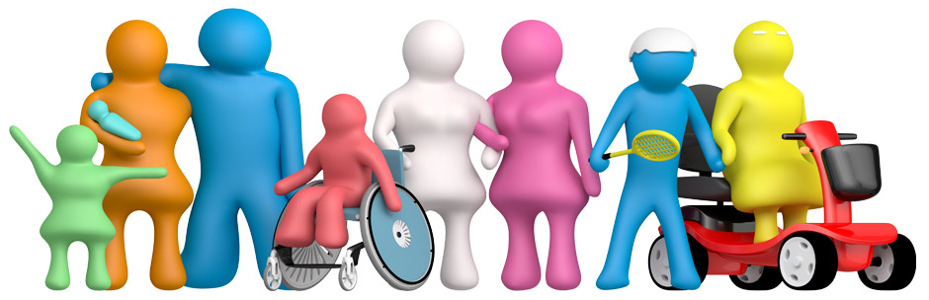
Equality
In legal situations, all Americans should be treated equally.
In a classroom, all students should be treated equally by their teachers.
Men and women should be treated equally.
There is not a strongly embedded social hierarchy or caste system.
For example, children may call an older adult by their name. If this happens to you, try to remember they are not being rude, but they have a different cultural value.

Slide 13
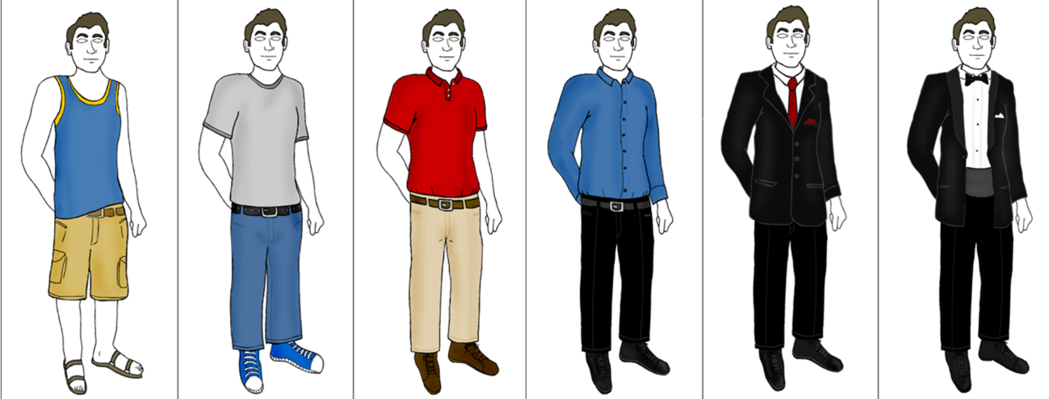
Informality
American society is often informal (relaxed).
Americans often dress casually: wearing jeans or shorts even at school, church, or appointments.
You use the same greeting for everyone (“Hi” or “Hello”).
Use of first names. In some situations, however, it is better to be more formal and to use last names until you are asked to use a first name – for example: students with their teachers.
Informal / Casual Business Casual Formal

Slide 14
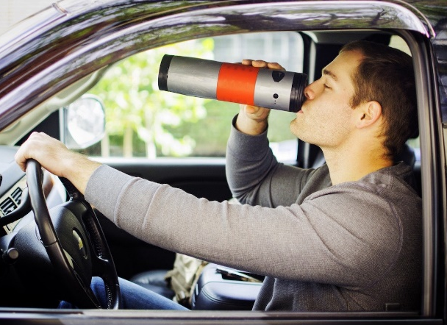
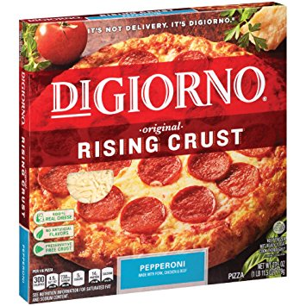
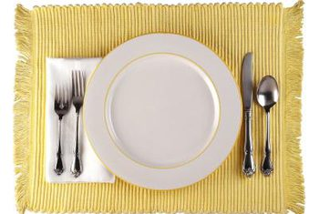
Eating Habits
“To go” food: Americans are always in a hurry it seems! Many restaurants offer food and drink you can eat while walking, driving, or to take with you somewhere else.
Working parents do not always have time to cook fresh meals. Grocery stores sell food “ready to eat”. These options are not always healthy. Fast food and microwavable meals should only be used when you really don’t have time to make healthy, fresh food.
Most Americans use silverware when sitting down to eat a meal, and everyone has a separate dish.

Slide 15
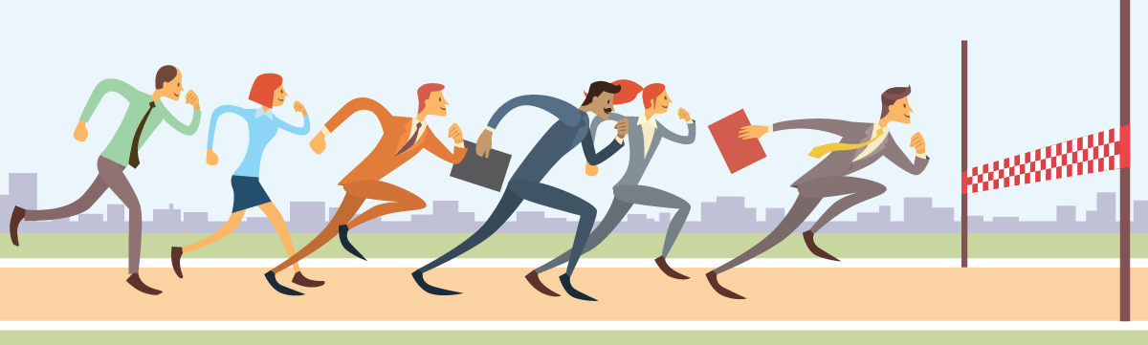
Competition
Americans can be competitive and are expected to work hard to achieve goals.
America’s business model is to compete for customers and for the best prices.
Americans schedule lots of activities. Even young children participate in lots of activities outside of school, such as sports, music lessons, and volunteering.
• Americans may also “compete” with themselves. Many Americans work hard to keep improving.
For example, they may want to run a race faster than they did last time or they may want to sell more items at their job than they did the year before.

Slide 16
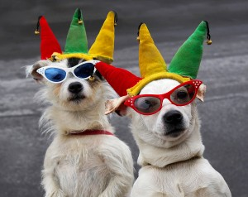
What’s something strange or funny you have noticed about American values or communication styles?

